Slide 1
Spend Level Employee Training (L2)
IDT 541 Multimedia Project Revision Presentation
3/7/2021 Kira Elma

Slide 2
Summary of Revisions
Changed the colors in the Main Menu
  Changed Introduction to blue-gray
  Changed Conclusion to blue-gray
  Changed Assessment to blue-gray
  Changed Focus Attention to red
  Changed Roadblock Exercise to red
  Changed Practice Quiz to light blue
  Changed Practice Exercise to light blue
Made Main Menu instructions larger and more clear
Rearranged the Main Menu to simpler format
Resized the Introduction text and added exit effects
Added an orientation menu to the Introduction slide
Changed the color of the shape on Focus Attention and Roadblock Exercise master slides to red
Changed the color of the shape on Practice Quiz master slide to light blue
Changed the color of the shape on Practice Exercise master slide to light blue
Increased the size of the “begin module” and “begin demo” buttons and moved to top right corner
Increased text size and reformatted lesson titles on Module 1 Overview slide
Increased text size of the lesson titles on Before the Demo slides
Resized the white bulleted text on Before the Demo slides and added exit effect
Resized the “Quote Request” box with text and delayed entrance
Changed the color of lesson # on Demo slides to blue
Changed the size of the drag elements for the drag & drop activities

Slide 3
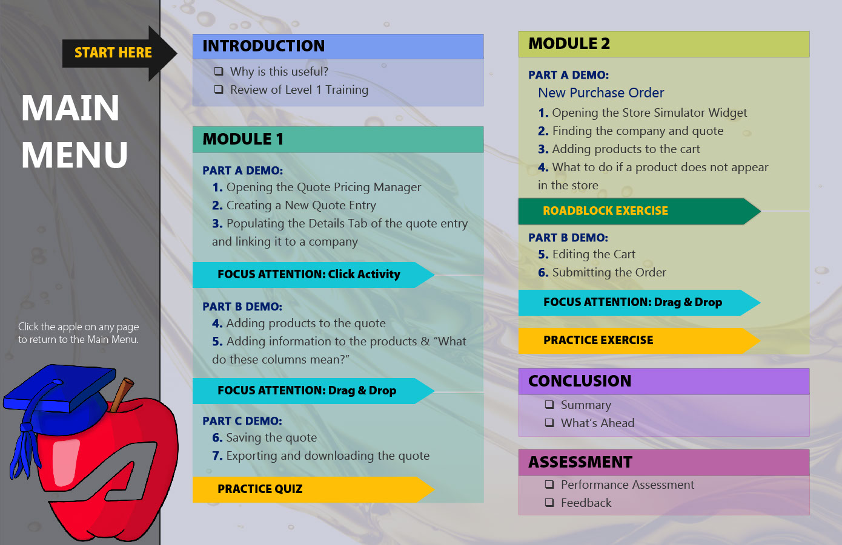
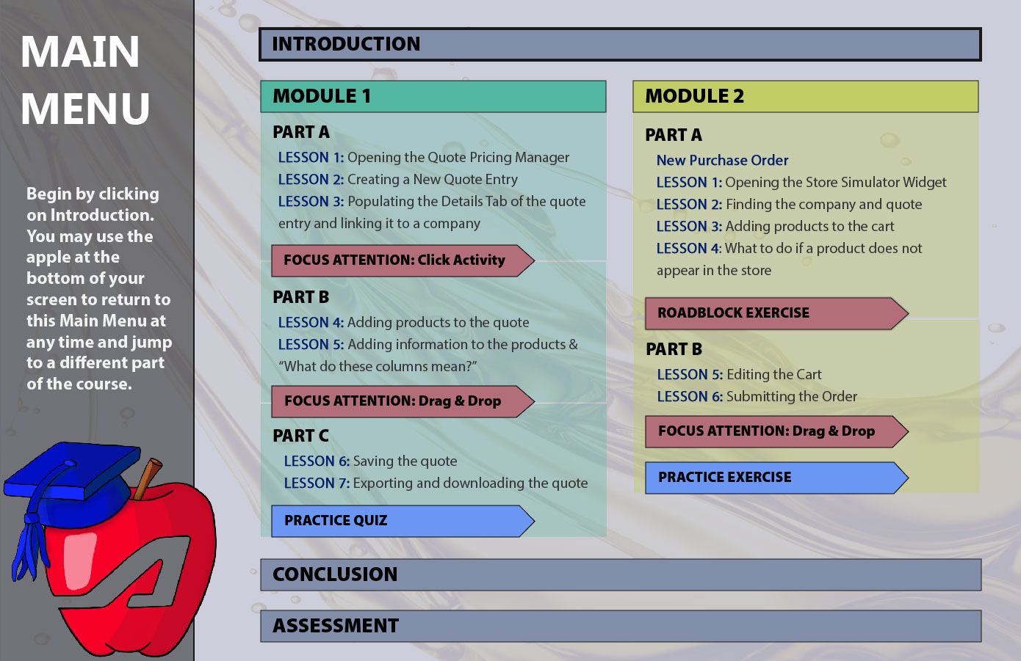
SLIDE 3:
Main Menu
Original Slide
Revised Slide
Moved “main menu” title up
Removed “start here” arrow
Enlarged caption and added more clear instructions
Changed the width and the color of “introduction,” “conclusion,” and “assessment” boxes to the same blue-gray
Removed the lesson text from underneath the “introduction,” “conclusion,” and “assessment”
Added bold border to “introduction” box
Added flicker effect to “introduction” box
Moved and resized “module 1” and “module 2” boxes
Added the word lesson in front of each lesson number
Changed “focus attention” arrows to the same red color
Changed “practice” arrows to the same blue

Slide 4
SLIDE 3:
Main Menu
MULTIMEDIA DESIGN PRINCIPLES
Multimedia
Signaling
Segmenting
Pre-training
SOLUTIONS:
Rearrangement of elements segments better and more clearly
Signaling with the black arrow was too much for the eye, the white text is simpler
Also added a flicker effect on the “Introduction” box for additional signaling
Reducing number of colors makes it less overwhelming & helps with pre-training

Slide 5
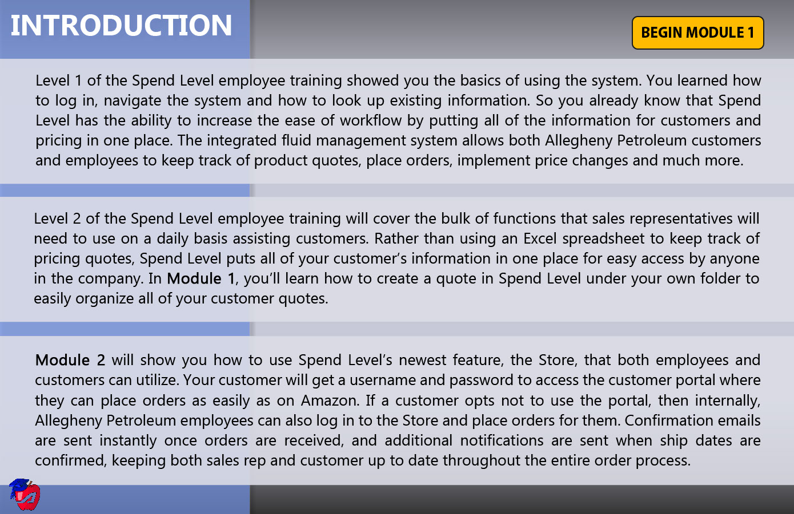
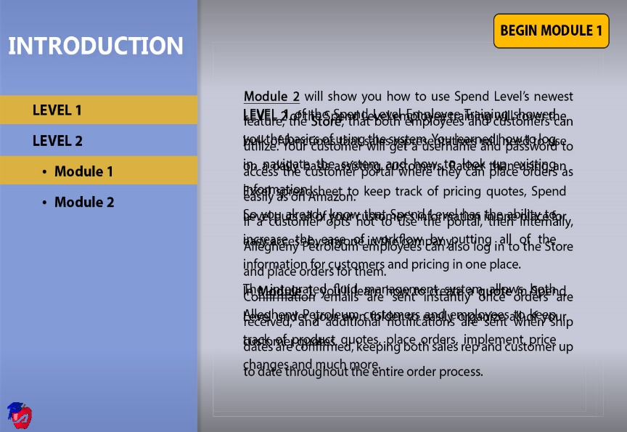
SLIDE 4:
Introduction
Original Slide
Revised Slide
Increased text size and line spacing
Resized paragraphs to fill the right space
Added exit effects to each of the paragraphs to disappear from screen as narration continues
Added a mini navigation pane that orients which lesson and module is being discussed with a moving yellow highlight box

Slide 6
SLIDE 4:
Introduction
MULTIMEDIA DESIGN PRINCIPLES
Multimedia
Personalization
Redundancy
Segmenting
Pre-training
SOLUTIONS:
Splitting the text so that it all isn’t on the screen at the same time helped with segmenting
Narration is ok with the text because there aren’t any other images
Added orientation on the left helps with pre-training so users can see what they have already learned and will learn in this course

Slide 7
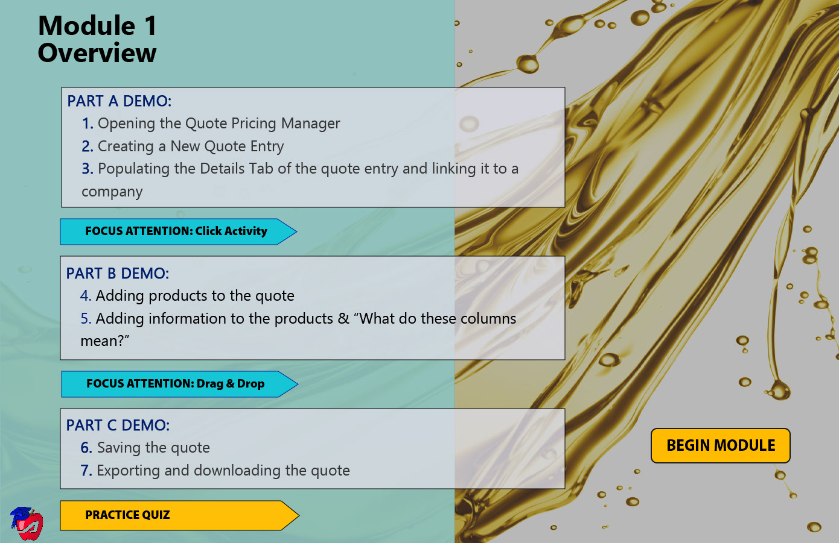
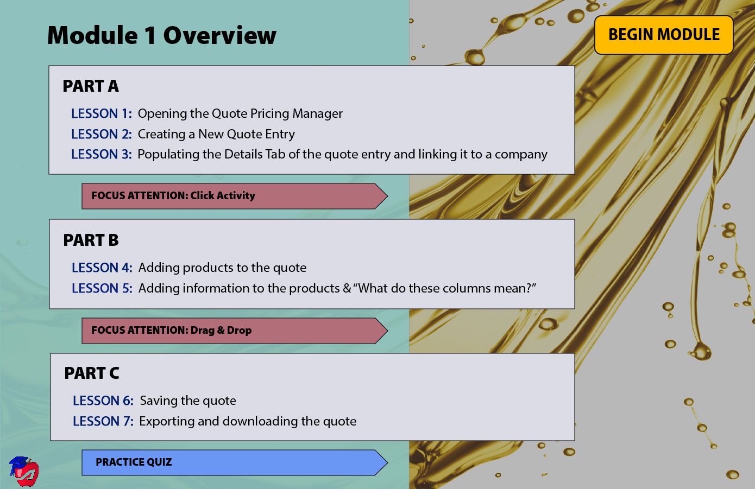
SLIDE 5:
Module 1 Overview
Original Slide
Revised Slide
Increased the size of “begin module” button and moved it to top right of screen
Reformatted “module 1 overview” title text
Changed color of “focus attention” arrows to red
Changed color of “practice quiz” arrow to blue
Resized “practice quiz” arrow

Slide 8
SLIDE 5:
Module 1 Overview
MULTIMEDIA DESIGN PRINCIPLES
Multimedia
Pre-training
Segmenting
Signaling
SOLUTIONS:
Resizing and recoloring of text made segmenting better
Recoloring of “Focus attention” and “practice quiz” arrows also helps with visual segmenting
Begin Module button being moved to top right helps signal the user to click there to begin since it is in the same place as the last slide

Slide 9
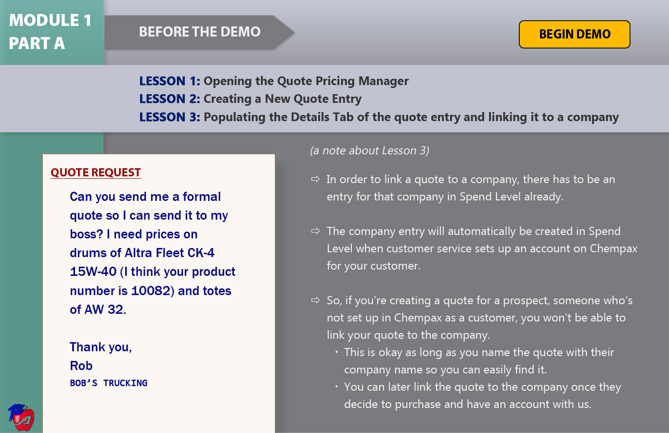
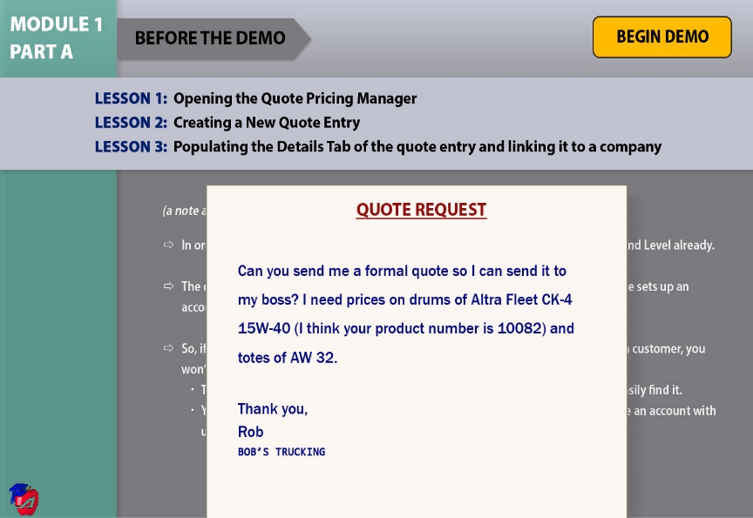
SLIDE 6:
Before the Demo (Part 1A)
Original Slide
Revised Slide
Increased the size of “begin demo” button
Changed font color of “begin the demo” title from white to black
Resized white bulleted text box to fill the whole bottom of the screen
Added exit effect to the white bulleted text box so that it disappears when the quote request appears
Resized and repositioned quote request shape and textbox to fill the whole bottom of the screen

Slide 10
SLIDE 6:
Before the Demo (Part 1A)
MULTIMEDIA DESIGN PRINCIPLES
Multimedia
Pre-training
Personalization
Redundancy
Segmenting
SOLUTIONS:
Narration with words is ok because there’s no competing graphics
Splitting the white text so that it’s not on the screen as the same time as the Quote Request box helps with segmenting
The white text being bulleted addresses the segmenting principle

Slide 11
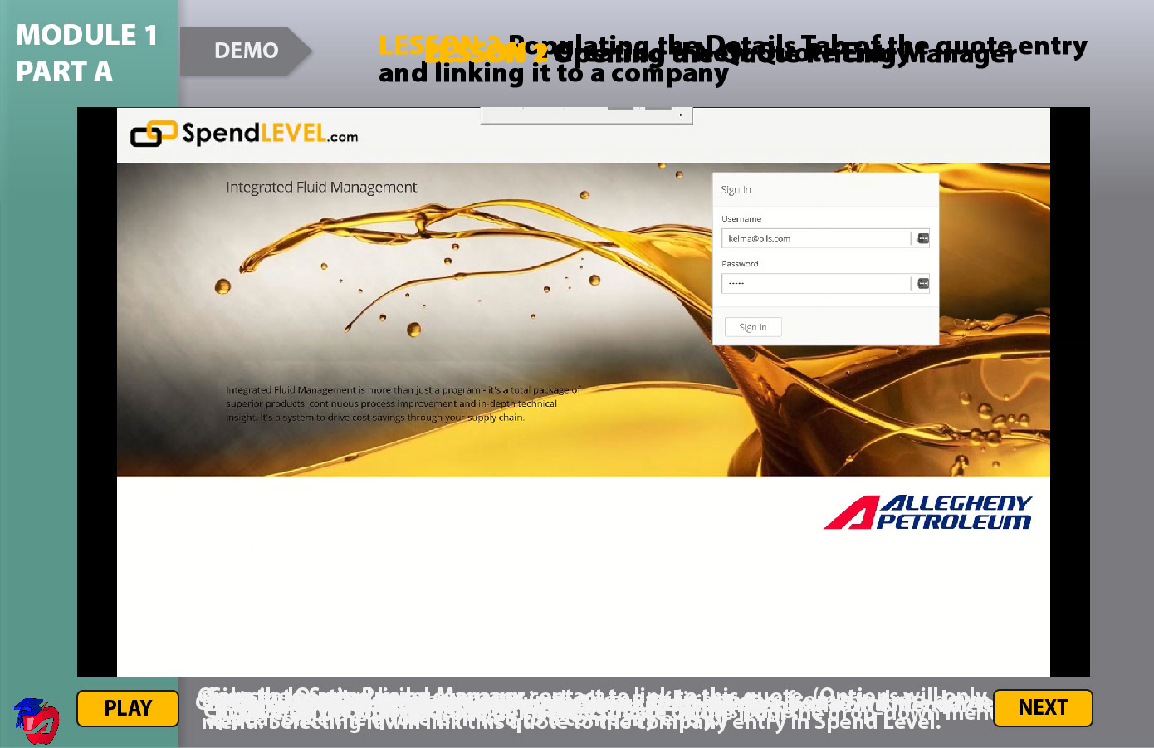
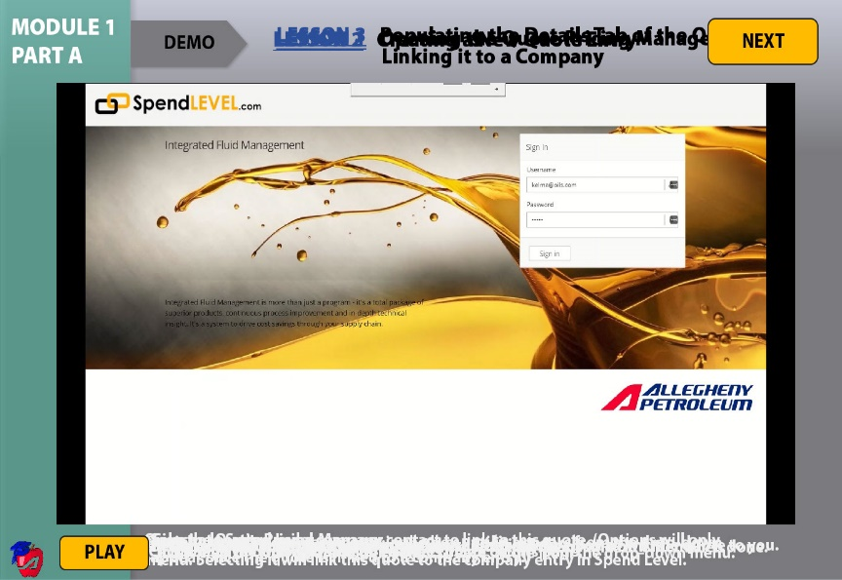
SLIDE 7:
Demo (Part 1A)
Original Slide
Revised Slide
Changed color of “demo” text from white to black
Changed color of “lesson” text from yellow to blue and underlined it
Moved “next” button to top right corner of screen

Slide 12
SLIDE 7:
Demo (Part 1A)
MULTIMEDIA DESIGN PRINCIPLES
Multimedia
Modality
Personalization
Signaling
Spatial Contiguity
SOLUTIONS:
Moving the Next button to the top right corner helps with signaling because it’s in the same place as all the other next buttons
The white captions at the bottom still need to be moved to help with spatial contiguity

Slide 13
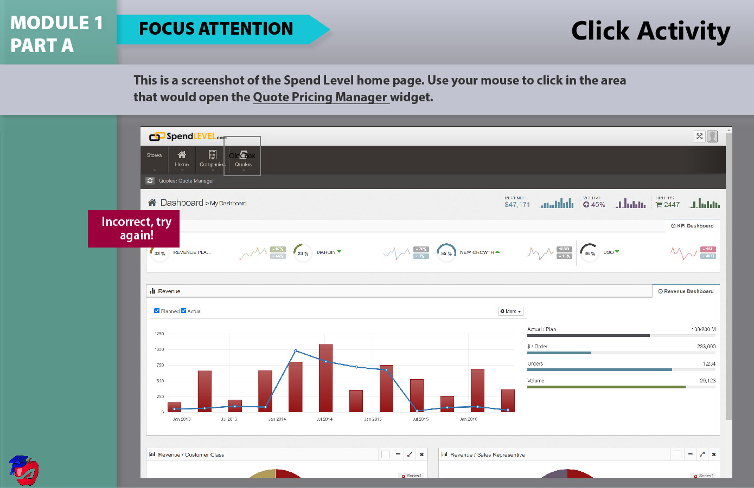
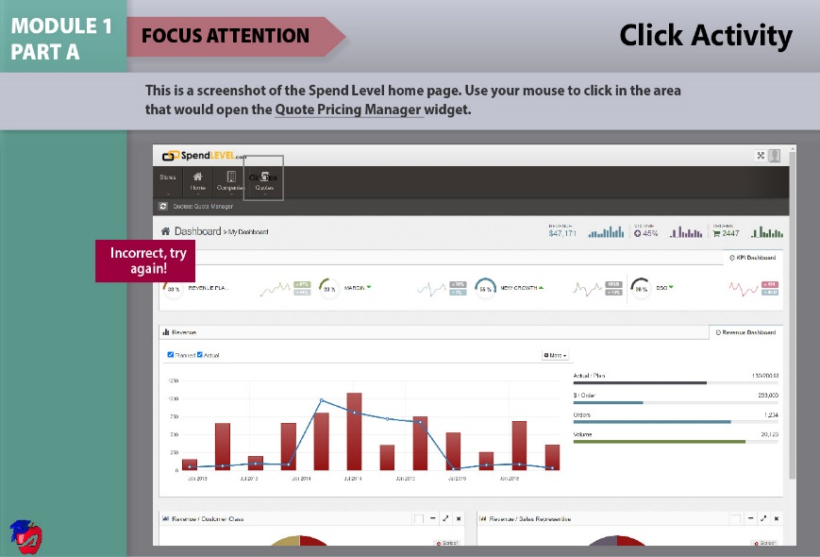
SLIDE 8:
Focus Attention – Click Activity
Original Slide
Revised Slide
Changed color or “focus attention” arrow to red

Slide 14
SLIDE 8:
Focus Attention –
Click Activity
MULTIMEDIA DESIGN PRINCIPLES
Multimedia
Personalization
Signaling
SOLUTIONS:
Changing the color of the Focus Attention title shape helps to signal to the user that this is a different part of the module; it is also the same color from the main menu

Slide 15
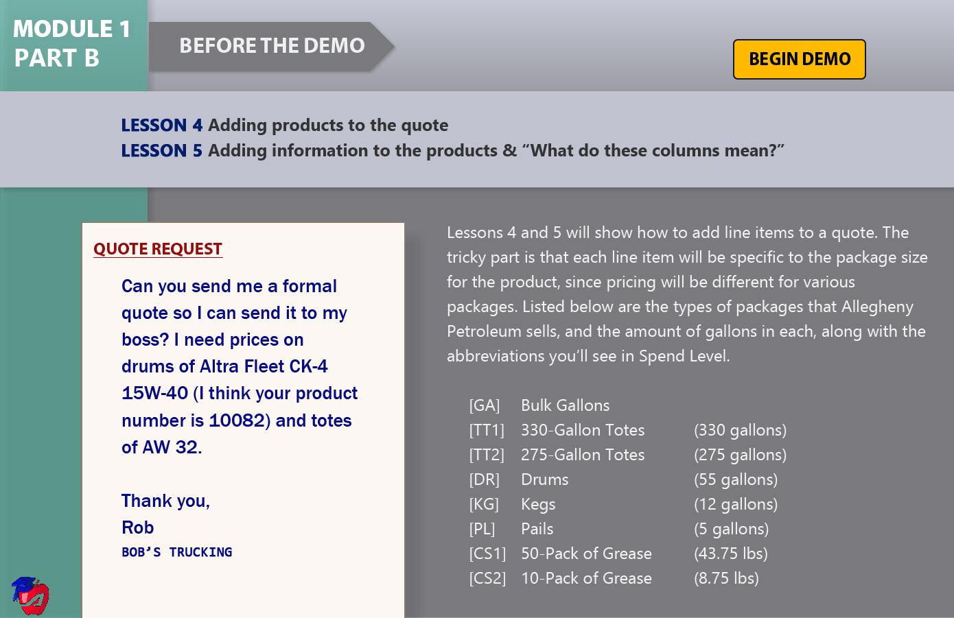
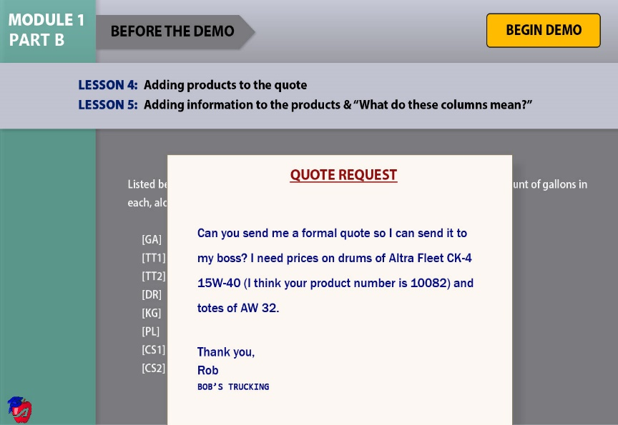
Original Slide
Revised Slide
SLIDE 10:
Before the Demo (Part 1B)
Increased the size of “begin demo” button
Changed font color of “begin the demo” title from white to black
Resized white bulleted text box to fill the whole bottom of the screen
Added exit effect to the white bulleted text box so that it disappears when the quote request appears
Resized and repositioned quote request shape and textbox to fill the whole bottom of the screen

Slide 16
SLIDE 10:
Before the Demo (Part 1B)
MULTIMEDIA DESIGN PRINCIPLES
Multimedia
Pre-training
Personalization
Redundancy
Segmenting
SOLUTIONS:
Narration with words is ok because there’s no competing graphics
Splitting the white text so that it’s not on the screen as the same time as the Quote Request box helps with segmenting
The white text being bulleted addresses the segmenting principle

Slide 17
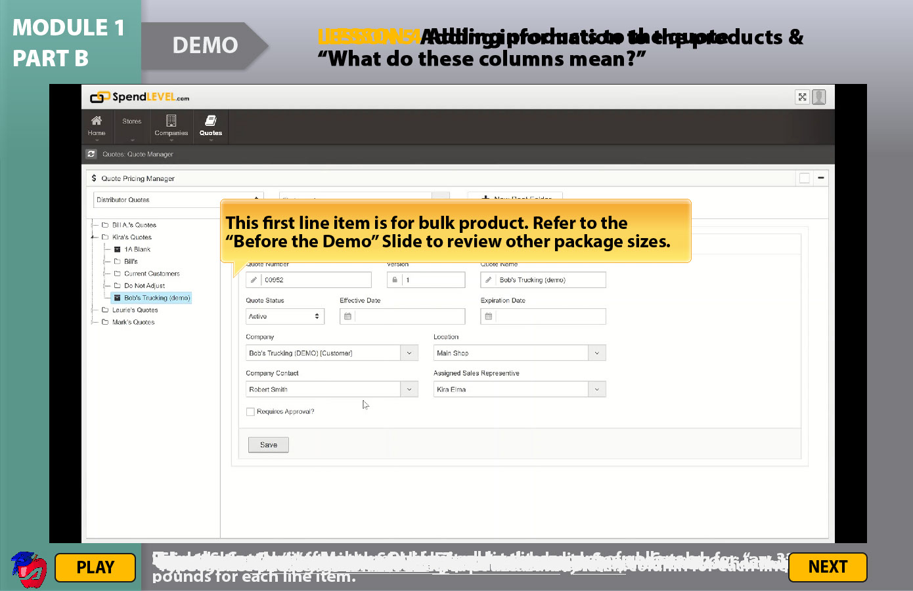
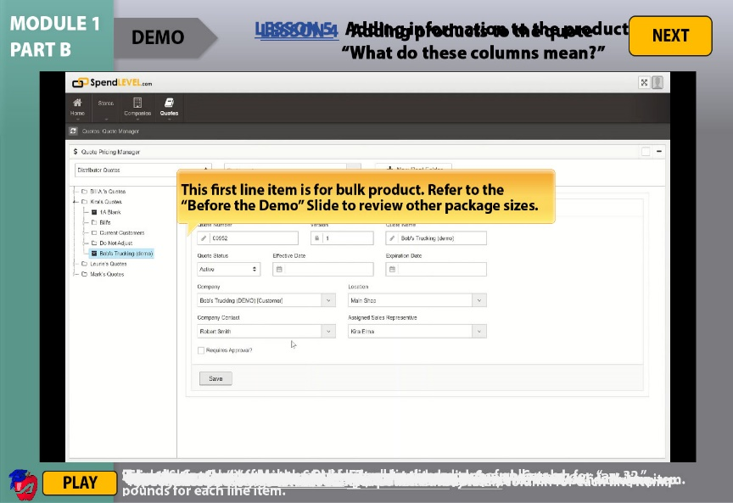
Original Slide
Revised Slide
SLIDE 11:
Demo (Part 1B)
Changed color of “demo” text from white to black
Changed color of “lesson” text from yellow to blue and underlined it
Moved “next” button to top right corner of screen

Slide 18
SLIDE 11:
Demo (Part 1B)
MULTIMEDIA DESIGN PRINCIPLES
Multimedia
Modality
Personalization
Signaling
Spatial Contiguity
SOLUTIONS:
Moving the Next button to the top right corner helps with signaling because it’s in the same place as all the other next buttons
The white captions at the bottom still need to be moved to help with spatial contiguity

Slide 19
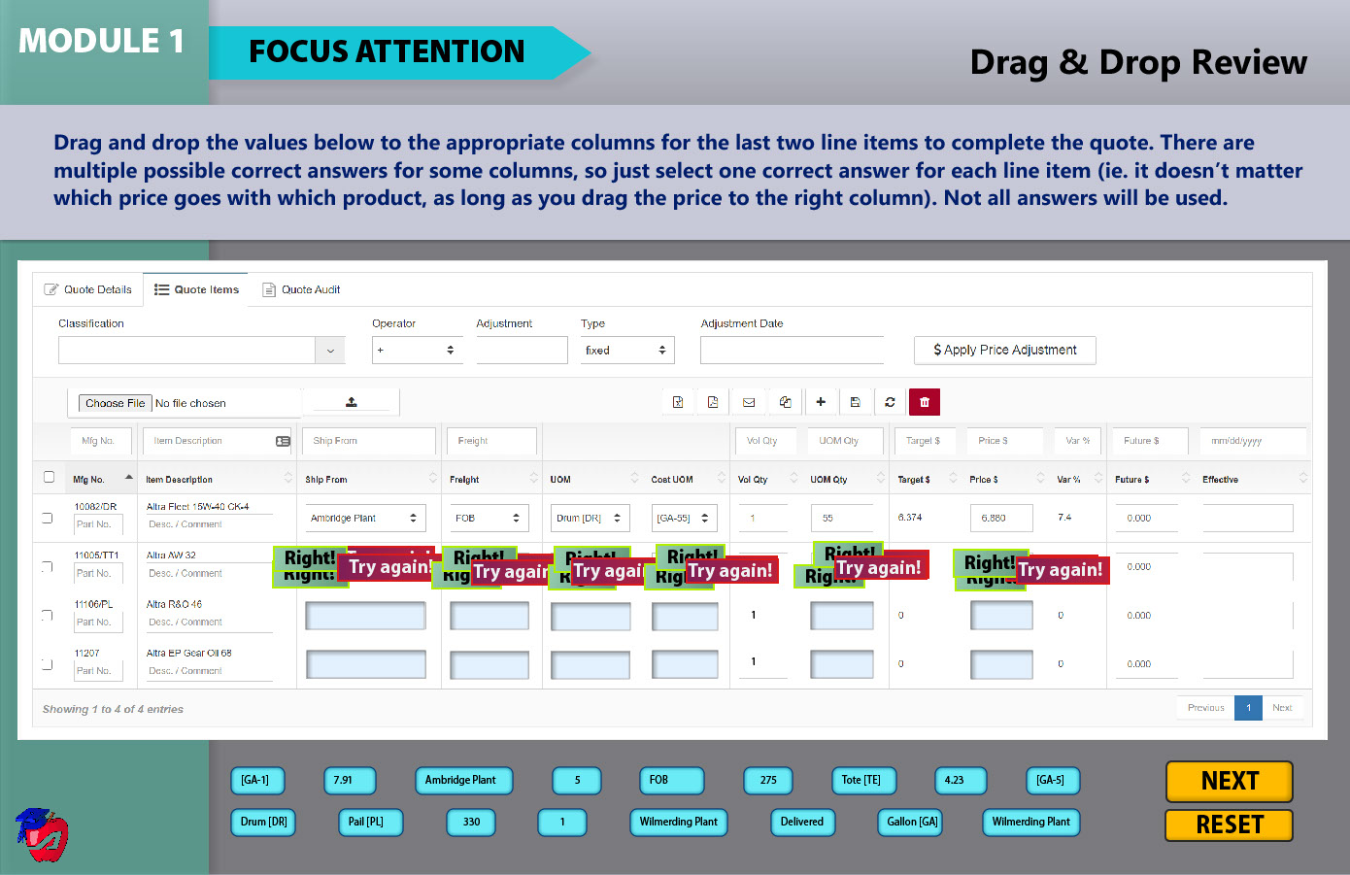
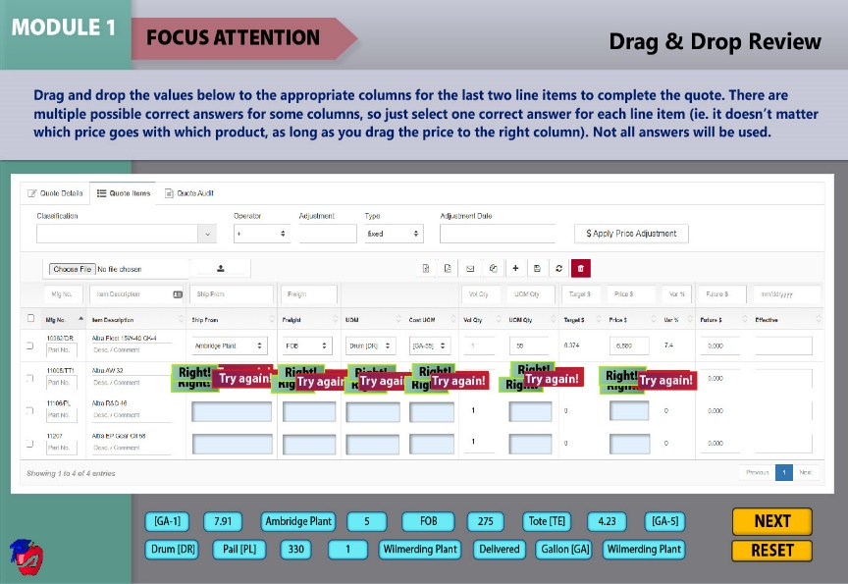
Original Slide
Revised Slide
Changed color of “focus attention” arrow to red
Increased the text size and box size of drag and drop elements
SLIDE 12:
Focus Attention – Drag & Drop Activity

Slide 20
SLIDE 12:
Focus Attention –
Drag & Drop Activity
MULTIMEDIA DESIGN PRINCIPLES
Multimedia
Personalization
Signaling
SOLUTIONS:
Changing the color of the Focus Attention title shape helps to signal to the user that this is a different part of the module; it is also the same color from the main menu
Feedback from Usability Test suggested an increase in font size for the drag elements to make it more legible

Slide 21
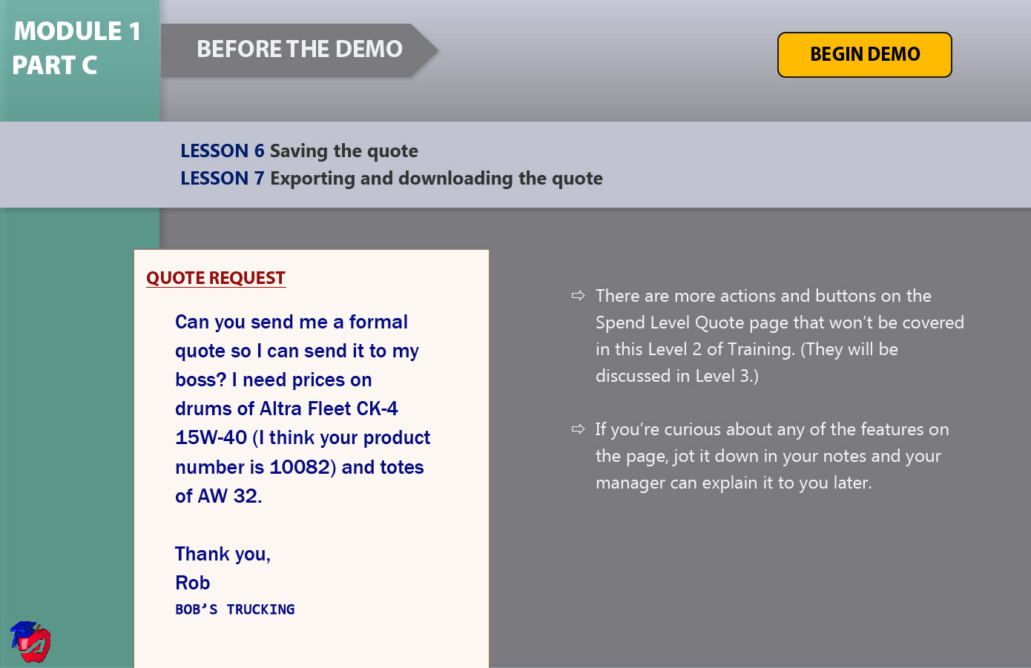
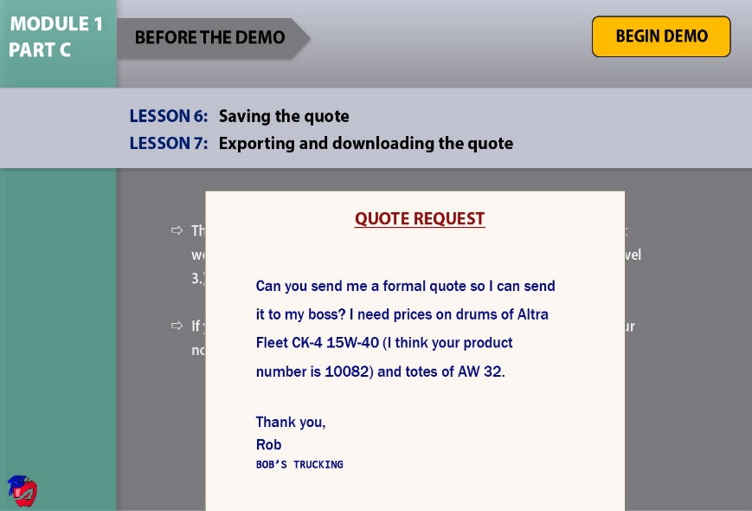
Original Slide
Revised Slide
Increased the size of “begin demo” button
Changed font color of “begin the demo” title from white to black
Resized white bulleted text box to fill the whole bottom of the screen
Added exit effect to the white bulleted text box so that it disappears when the quote request appears
Resized and repositioned quote request shape and textbox to fill the whole bottom of the screen
SLIDE 13:
Before the Demo (Part 1C)

Slide 22
SLIDE 13:
Before the Demo (Part 1C)
MULTIMEDIA DESIGN PRINCIPLES
Multimedia
Pre-training
Personalization
Redundancy
Segmenting
SOLUTIONS:
Narration with words is ok because there’s no competing graphics
Splitting the white text so that it’s not on the screen as the same time as the Quote Request box helps with segmenting
The white text being bulleted addresses the segmenting principle

Slide 23
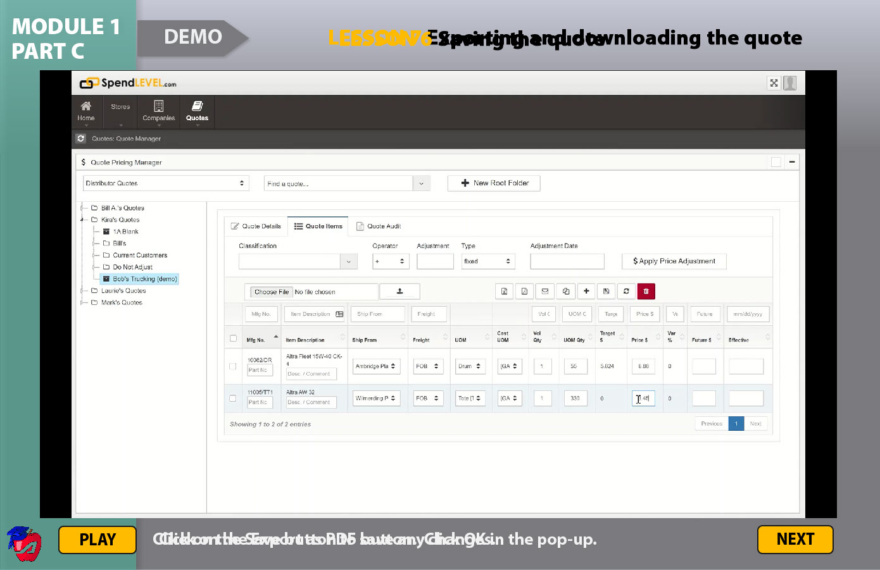
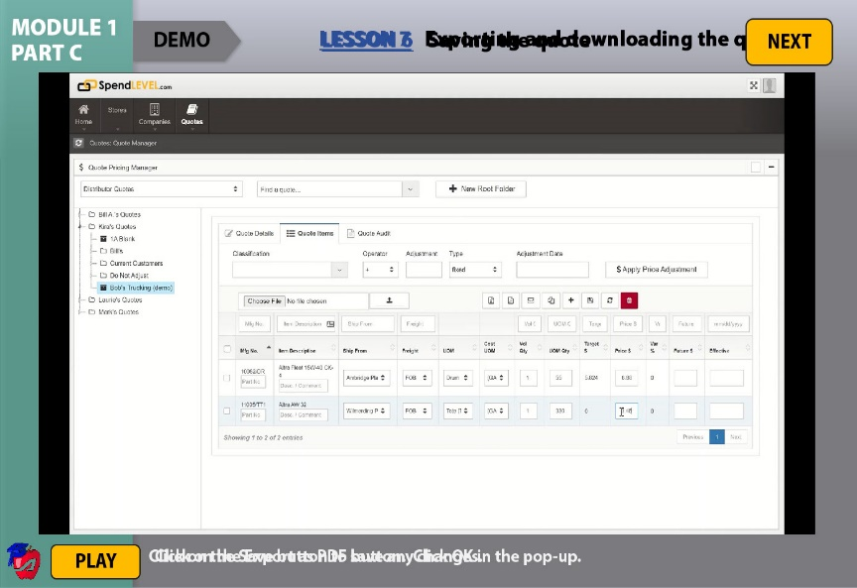
Original Slide
Revised Slide
SLIDE 14:
Demo (Part 1C)
Changed color of “demo” text from white to black
Changed color of “lesson” text from yellow to blue and underlined it
Moved “next” button to top right corner of screen

Slide 24
SLIDE 14:
Demo (Part 1C)
MULTIMEDIA DESIGN PRINCIPLES
Multimedia
Modality
Personalization
Signaling
Spatial Contiguity
SOLUTIONS:
Moving the Next button to the top right corner helps with signaling because it’s in the same place as all the other next buttons
The white captions at the bottom still need to be moved to help with spatial contiguity

Slide 25
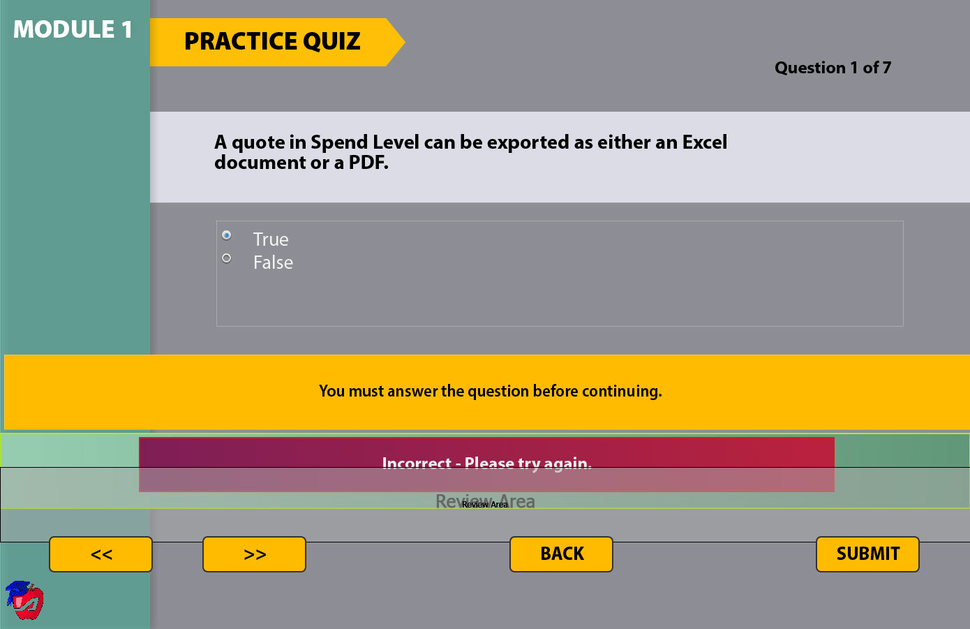
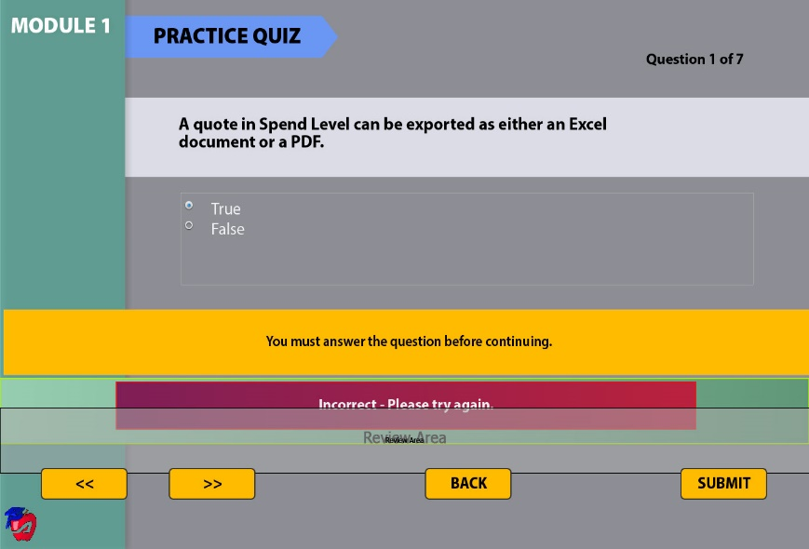
Original Slide
Revised Slide
SLIDE 15:
Practice Quiz – Question #1
Changed color or “practice quiz” arrow to light blue

Slide 26
SLIDE 15:
Practice Quiz –
Question #1
MULTIMEDIA DESIGN PRINCIPLES
Multimedia
Personalization
Signaling
SOLUTIONS:
Changing the color of the Practice Quiz title shape helps to signal to the user that this is a different part of the module; it is also the same color from the main menu

Slide 27
Any suggestions?
Questions?
Kira Elma
Spend Level Employee Training (L2)
IDT 541: Advanced Multimedia Design

