Slide 1
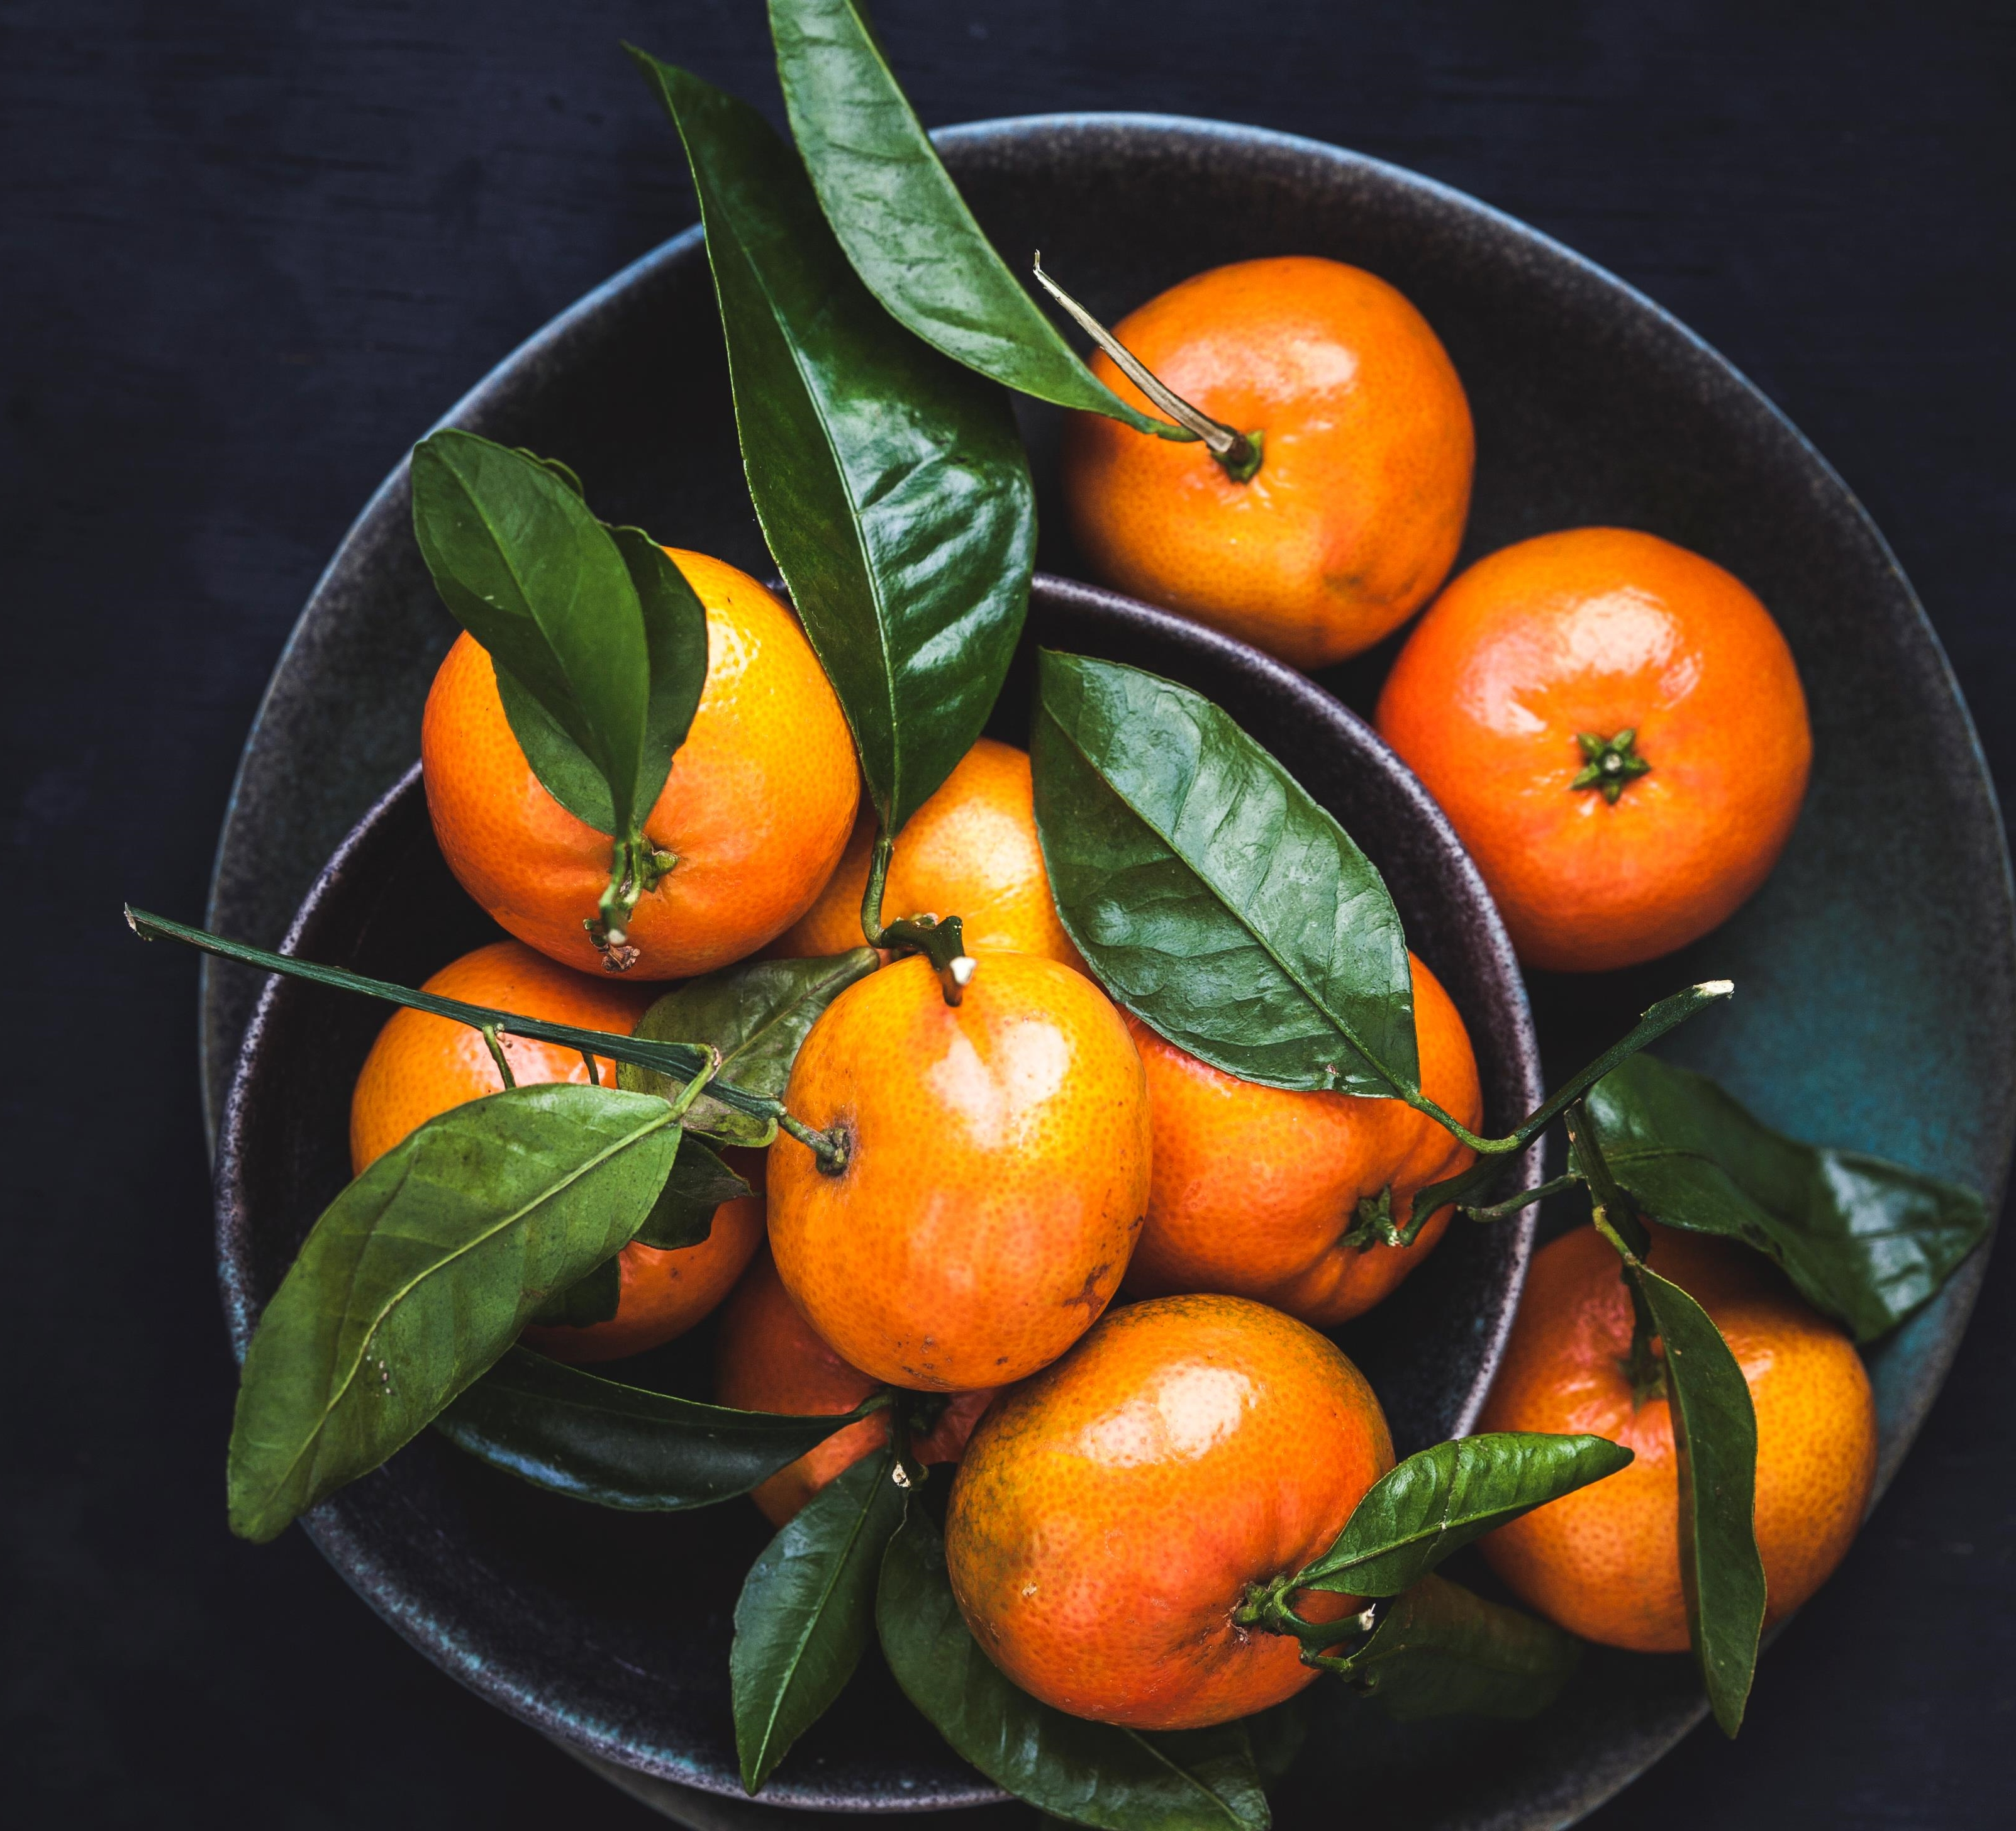

Program rules and Meal Planning
Kira Elma
Notes:
This short presentation will go through a few parts of the Whole30 diet; program rules and meal planning. Essentially, it’s what you can and can’t eat during your Whole30.

Slide 2

Introduction
Short-term self-experiment
  30 days of elimination
  10-30 days of reintroduction
Eliminate processed foods
Eat whole foods only
“The foods I eliminate are not bad, they’re just unknown.”
Notes:
The gist of the diet is that you avoid processed foods, and turn to whole foods, but it’s so much more than that. You remove typical problematic food groups from your diet for 30 days, then you reintroduce them one at a time and observe their effects on your body. It’s not a diet, but more of a little self-experiment to learn how your body reacts to certain foods.
The thing that makes Whole30 so unique is that you focus on providing your body with the fuel that it needs to be healthy, and make conscious choices about your eating habits. There’s a document that I really like on the Whole30 website called the “Mindset Checklist” and part of it says, the foods I eliminate are not bad, they’re just unknown. If you want to see the rest of the checklist, you can click this icon here. With Whole30, there’s no emphasis on counting calories, labeling foods as ‘bad’ or tracking progress with the scale.
In fact, that’s one of the program rules!

Slide 3



Program Rules
No Scale or Body Measurements
No “approved” junk food
Whole30 is not a weight-loss diet, it’s a lifestyle change.
Whole30 can teach you to break poor eating habits.
Only non-scale victories!
Less body aches
Decreased bloating
Visibly better skin
Don’t look for ways to cheat
Just because it’s “approved” doesn’t mean it’s right – that’s not the point!
Notes:
There are 8 main rules for the program, and two of them are based on mentality.
The first is no daily weigh-ins, and no body measurements - only non-scale victories! Whole30 is not a weight-loss diet, it’s a lifestyle change. During the 30 days of this program, you’re not allowed to track any measurements, instead encouraged to notice changes in your health, like less body aches, less bloating, or better skin.
Another rule of the program is to refrain from creating “cheat” meals that are technically compliant. You’ll see on the next slide all of the non-compliant foods, and then we’ll talk about foods that are permitted with the program. Once you see these lists, it’ll be tempting to want to satisfy your pancake craving with a healthy ‘banana and almond flour’ alternative, but that’s against the rules. Try not to consume baked goods, junk foods, or treats even if they have “approved” ingredients in them. This isn’t the point of Whole30. Finding a way to eat these foods won’t help you break that eating habit, and it’s more likely you’ll just go right back to the real thing after 30 days.
To take a closer look at the program rules, click on this icon in the bottom right.

Slide 4
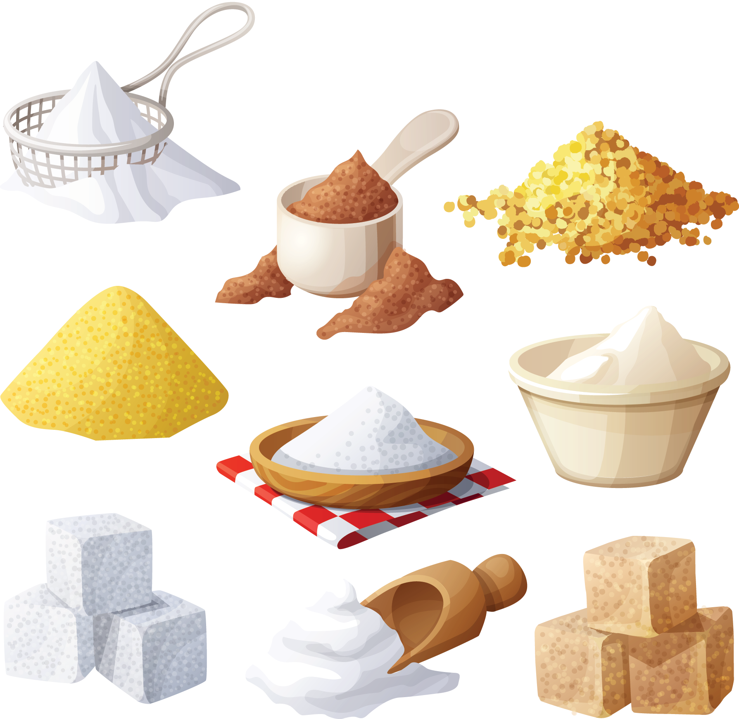
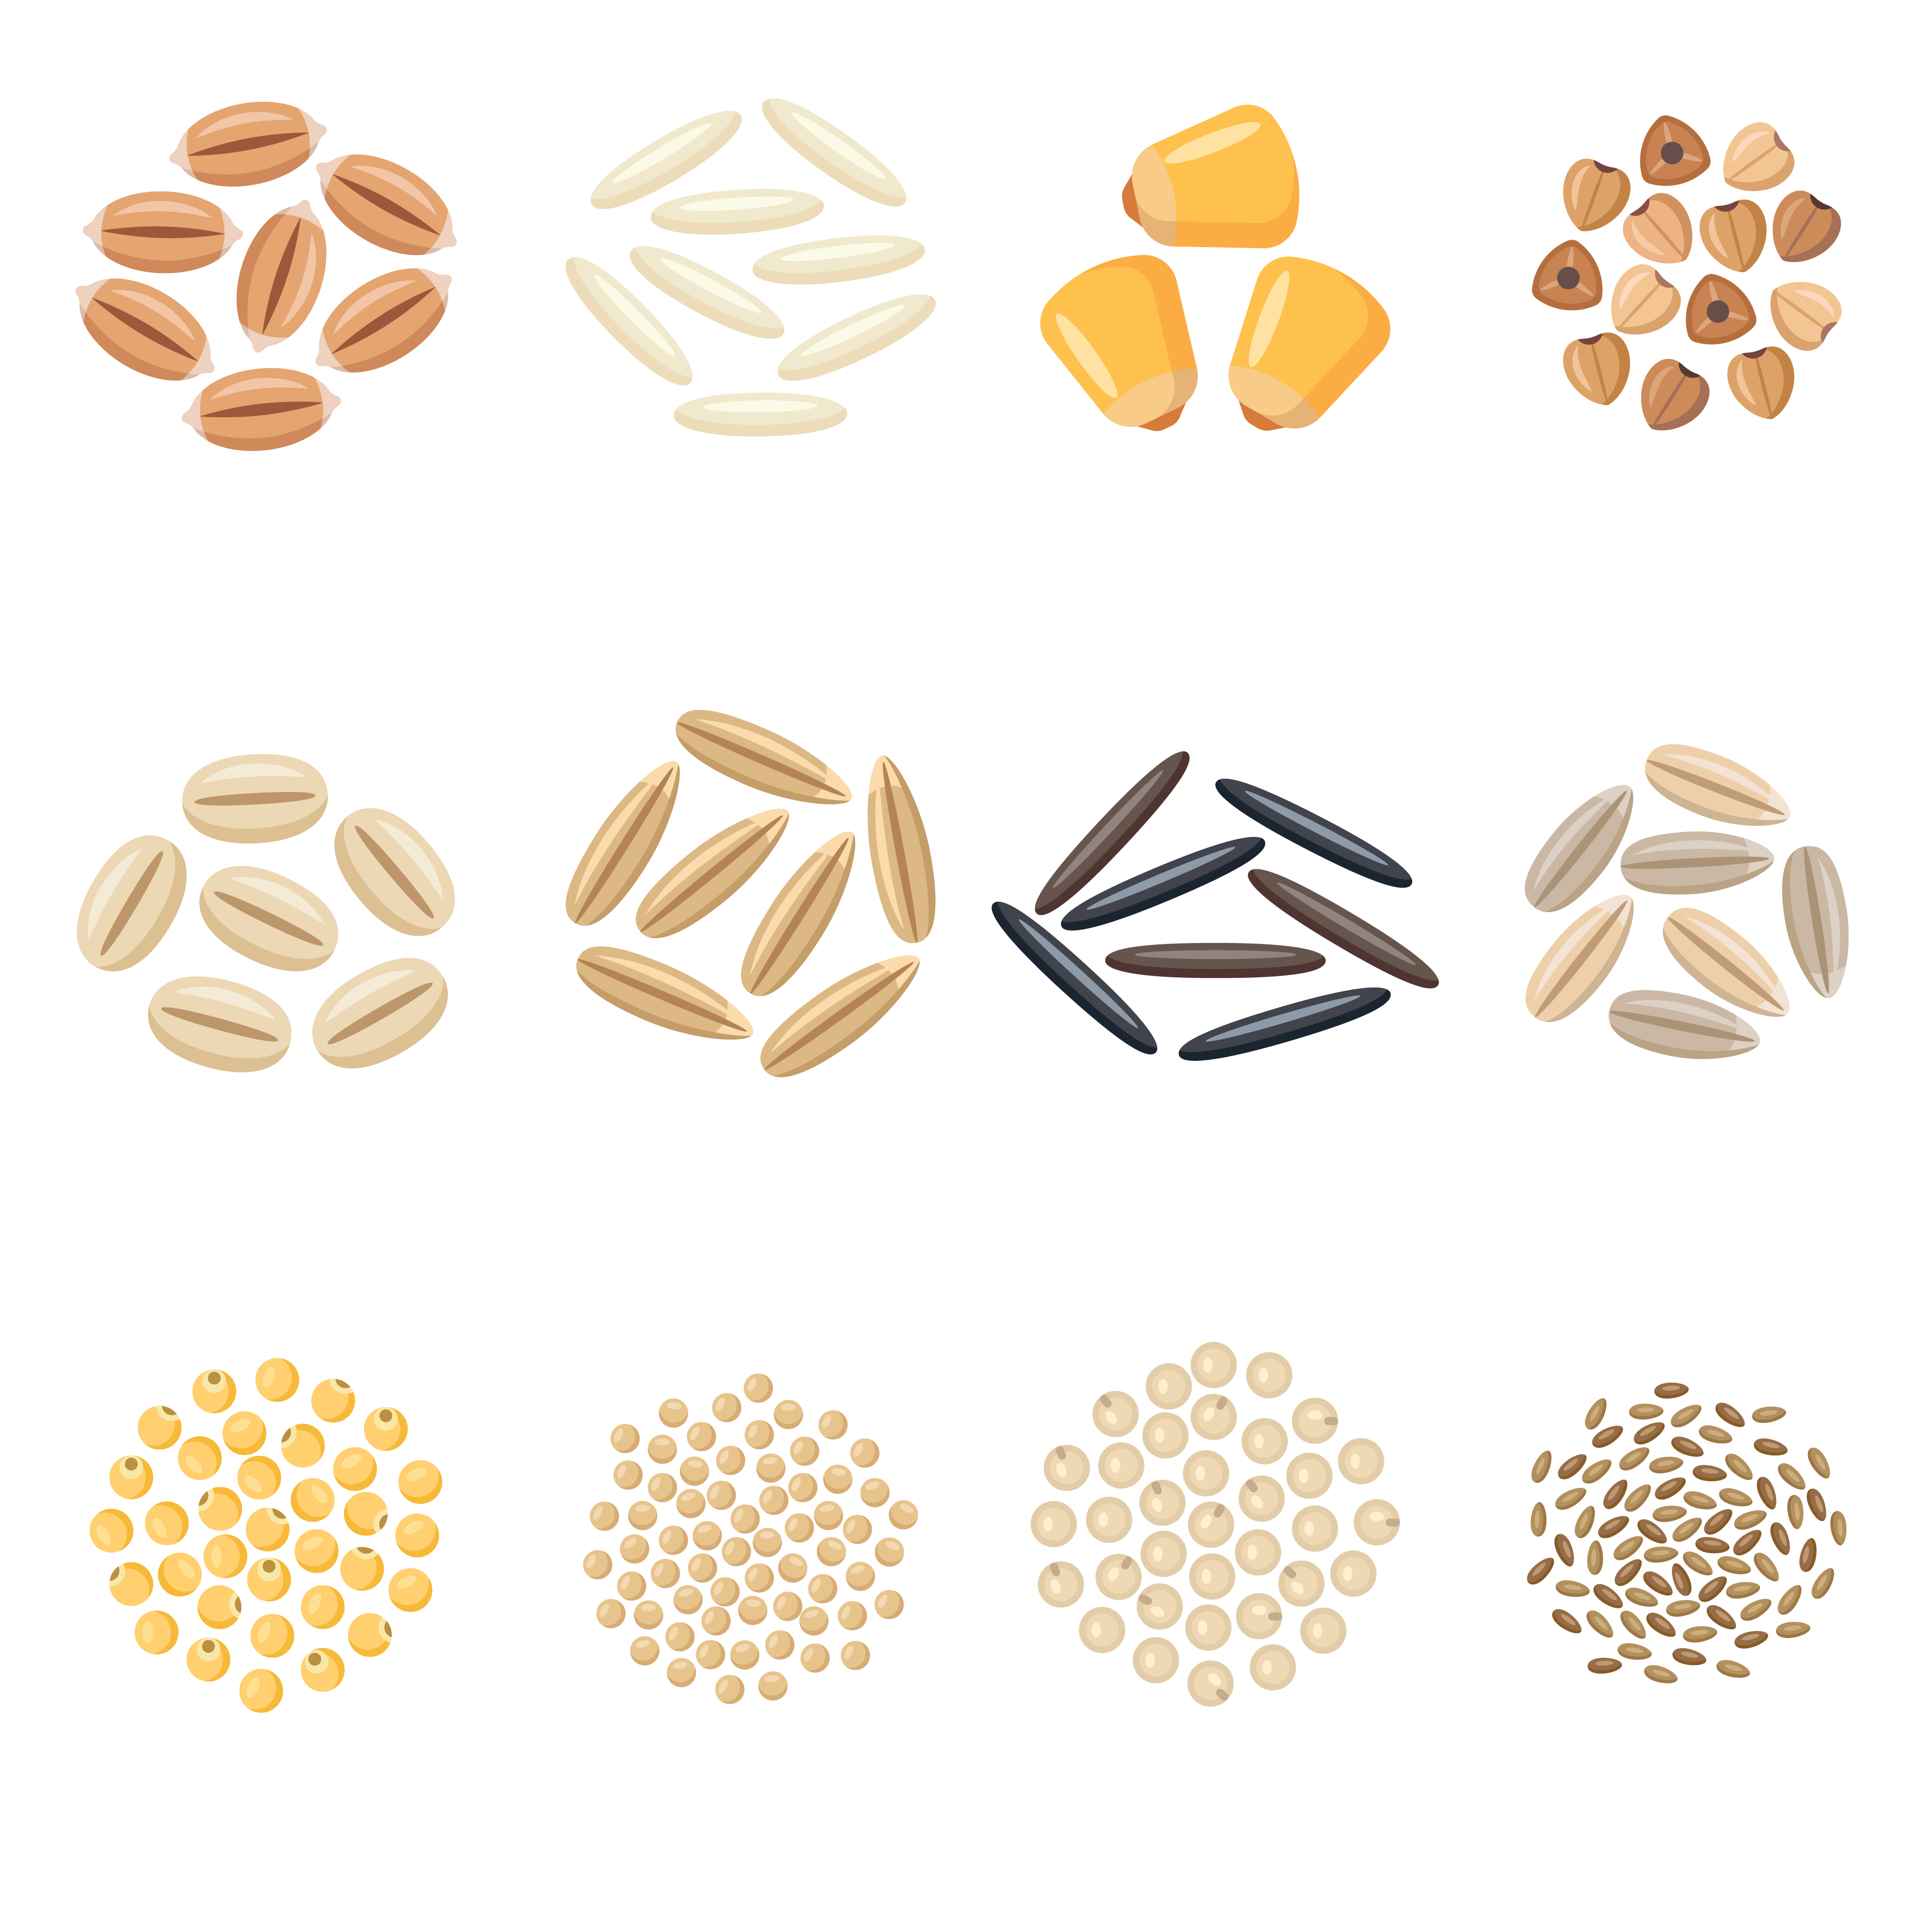
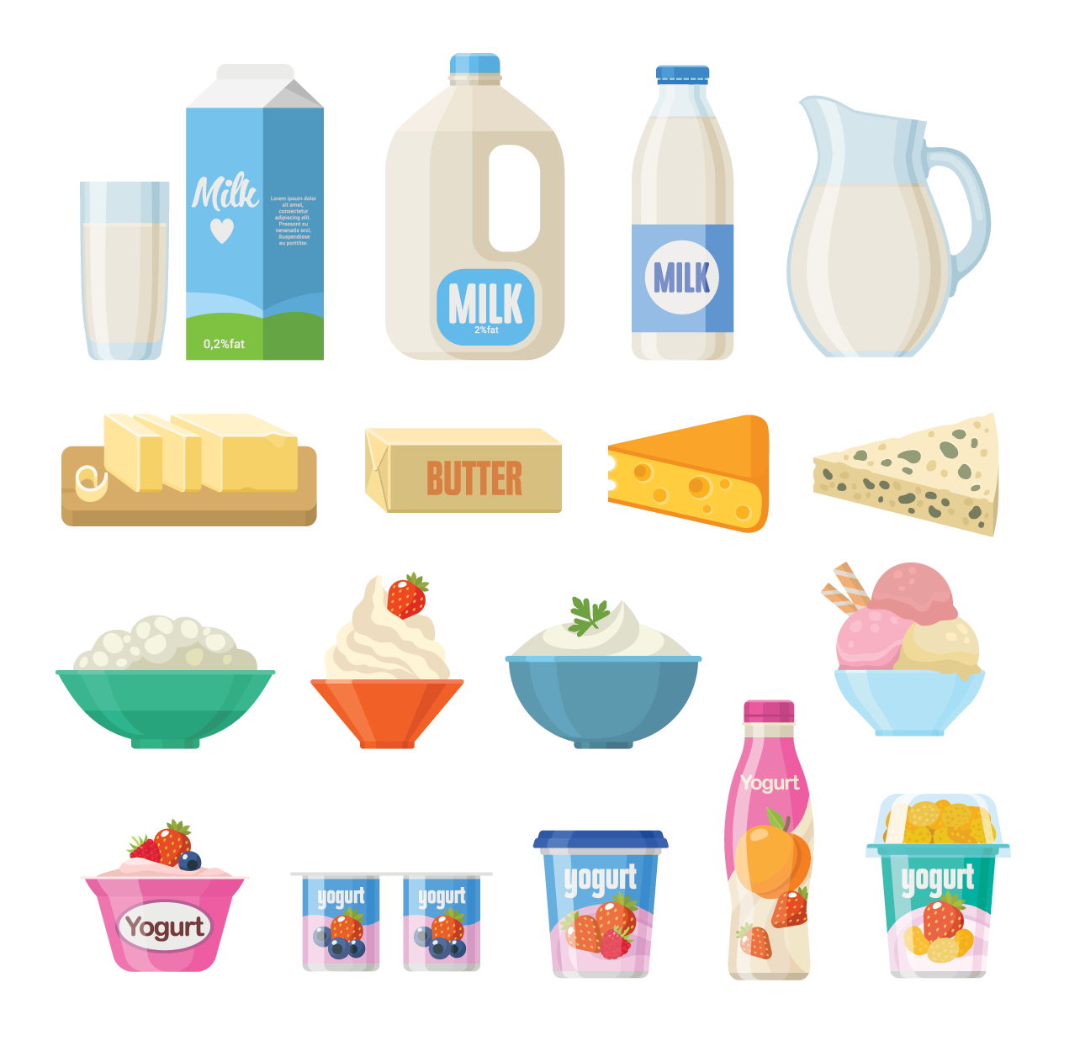
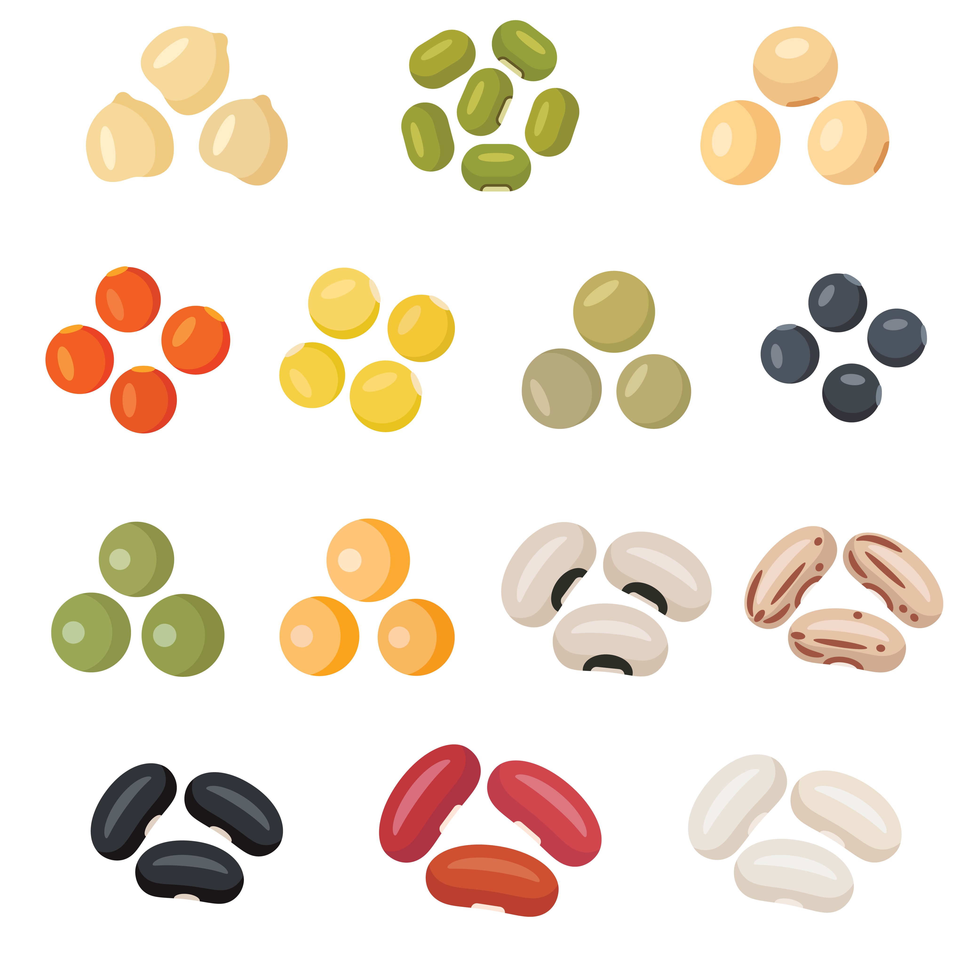

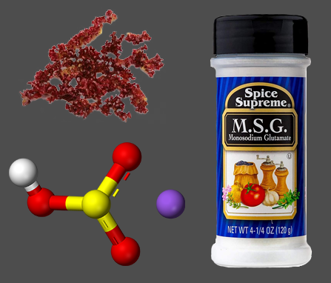
Program Rules
No sugar
No Grains
No Dairy
No legumes
No Alcohol
No carrageenan, MSG, or sulfites
Notes:
The remainder of the program rules define the 6 food groups to be eliminated. These are: no sugar, no grains, no dairy, no legumes, no alcohol, and no carrageenan, msg or sulfites. Let’s take a closer look at each of these.

Slide 5

Program Rules
Including (but not limited to):
Check the Label for:
Brown sugar
Cane sugar
Raw sugar
Confectioner’s sugar
Honey
Maple syrup
Molasses
Malt syrup
Stevia
Splenda
Equal
Nutra-Sweet
Sweet-n-Low
Sweetleaf
Truvia
Agave nectar
Coconut nectar
Coconut sugar
Date sugar
Cane juice
Refiner’s syrup
Rice syrup
Date syrup
High fructose corn syrup
Acesulfame-K
Arabitol dulcitol
Aspartame
Dextrose
Disaccharide
Erythritol
Fructose
Galactose
Glucose
Glycerin (glycerol)
Glycol
High fructose corn syrup
HSH
Iditol
Isomalt
Lactitol
Lactose
Maltitol
Maltose
Mannitol
Monk fruit extract
Monosaccaharide
Polyglycitol
Polysaccharide
Ribitol
Ribose
Rice malt extract
Saccharin
Saccharose
Sorbitol
Sucralose
Sucrose
Sweet sorghum
Threitol
Treacle
Xylitol
No Sugar
Practice your Label Reading
Exceptions:
Fruit juice as sweetener
Notes:
For Whole30 you can’t have any added sugar; natural, or artificial. So this includes regular sugar, brown sugar, honey, stevia, splenda, maple syrup - any kind of sugar is out. I think sugar is the most difficult to eliminate from the diet, just because it’s hidden in so many things. Which means you’re going to have to become familiar with reading the ingredients label on everything you buy.
(click) There’s a great document from the Whole30 website called “Practice your Label Reading.” If you want to take a look at it, use the magnifying glass icon to link to it. It lists all of these tricky words to look for that are just another type of sugar like high fructose corn syrup, glucose, maltose, ribose, sorbitol, sucralose.
(click) The makers of Whole30 understand that we live in a complex world of food, so there are some exceptions for these eliminated food groups. In this case, you are allowed the natural sugar that comes from fruit, so you can use fruit juice as a sweetener.

Slide 6
Program Rules
Including (but not limited to):
Check the Label for:
Wheat
Rye
Barley
Oats
Corn
Rice
Millet
Flour
Starch
Quinoa
Amaranth
Buckwheat
Bran
Corn oil
Rice oil
Sprouted grains
Bread
Bread crumbs
Granola bars
Croutons
Crescent rolls
Crackers
Rice noodles
Brown rice
Tortillas
Chips
Pizza crust
Cookies
Biscuits
Pancakes
Muffins
Waffles
Cereal
Bagels
Pasta
Oatmeal
Gummies
Cake
Brownies
Barley Grass
Bulgur
Durum
Durum flour
Durum wheat
Einkorn
Emmer
Farina
Flour
Farro
Fu
Kamut
Seitan
Semolina
Sorghum
Starch
Spelt
Sprouted wheat
Triticale
Triticum aestivum
Wheat berries
Wheat bran,
Germ
Germ oil
Germ extract
Gluten
Grass
Malt
Starch
Wheat protein
Hydrolyzed wheat protein
No Grains
Exceptions:
Vinegar
Botanical extracts
(limit) sesame oil
(limit) canola oil
Notes:
The next eliminated food group for Whole30 is grains. Including gluten-free. So, no wheat, rye, barley, oats, corn, rice, or grain ingredients like that. This list is not all-inclusive, but it should give you an idea of the category of grains.
(click) In terms of foods, this means no bread, no crackers, cereal, bagels, waffles, tortilla chips, pasta, etc.
(click) There are a lot of foods with grains, so always check your ingredients label. Other than the obvious words like wheat, starch, and flour, these are some other ingredients that indicate grains. Sorghum is one I see often. Also notice wheat bran and wheat germ.
(click) The exceptions for the grains category are vinegar and botanical extracts. Additionally, you’re permitted to have sesame oil and canola oil but in very limited quantities.

Slide 7
Program Rules
Including (but not limited to):
Check the Label for:
Cow milk
Sheep milk
Goat milk
Cheese
Butter
Margarine
Cream
Yogurt
Buttermilk
Kefir
Sour cream
Ice cream
Frozen yogurt
Cream cheese
Cottage cheese
Heavy cream
Coffee creamer
Half & Half
Ranch
Cesar dressing
Creamy soups
Whey protein
Custard
Pudding
Chocolate
Cake mix
Icing
Whipped Cream
Curds
Cream sauce
Alfredo sauce
Nougat
Acidophilus Milk
Ammonium Caseinate
Butter Esters
Butter Fat
Butter Oil
Butter Solids
Buttermilk Powder
Calcium Caseinate
Casein
Caseinate (in general)
Condensed Milk
Dry Milk Powder
Dry Milk Solids
Evaporated Milk
Hydrolyzed Casein
Hydrolyzed Milk Protein
Iron Caseinate
Lactalbumin
Lactoferrin
Lactoglobulin
Lactose
Lactulose
Low-Fat Milk
Magnesium Caseinate
Malted Milk
Milk Derivative
Milk Fat
Milk Powder
Milk Protein
Milk Solids
Natural Butter Flavor
Paneer
Potassium Caseinate
Recaldent
Rennet Casein
Sodium Caseinate
Sour Milk Solids
Sweetened Condensed Milk
Whey
Zinc Caseinate
No dairy
Exceptions:
Ghee
Clarified butter
Notes:
Next is no dairy: including cow, goat, and sheep’s milk. No cheeses, butter, or creams. So in terms of food, this means no ice cream, no cream sauces, no yogurt, and no coffee creamer.
(click) Again, the list here is not all-inclusive, so be sure to check your labels. It won’t be enough just to check for dairy under the allergens part of the food label. Here is a list of ingredients to look for that indicate a presence of dairy.
(click) Exceptions to this program rule are ghee and clarified butter. From personal experience, ghee is just as good if not better than regular butter.

Slide 8
Program Rules
Including (but not limited to):
Check the Label for:
Black beans
Pinto beans
Lima beans
Kidney beans
Mung beans
White beans
Soy beans
Red beans
Beans
Green peas
Black eyed peas
Chickpeas
Red lentils
Green lentils
Yellow lentils
Black lentils
Soy
Soy lecithin
Soybean oil
Soy sauce
Peanuts
Peanut butter
Peanut oil
Tamarind
Fenugreek
Miso
Tofu
Kyodofu
Tempeh
Edamame
Carob
Guar gum
Kinako flour
Lecithin
Lupin
Locust bean gum
Monoglycerides
Diglycerides
Natto
Okara (soy pulp)
Pea Protein
Shoyu
Soybean
Soya
Supro
Tamari
Tempeh
Teriyaki sauce
Textured soy flour (TSF)
Textured soy protein (TSP)
Textured vegetable protein
Textured vegetable protein (TVP)
Tofu
Yakidofu
Yuba
No Legumes
Exceptions:
Green beans
Snow peas
Snap peas
Coconut aminos
Notes:
The next program rule for Whole30 is no legumes. Though these foods are usually considered healthy by most people, they commonly cause inflammatory issues, so it’s good to check their effect on you individually. This includes all types of beans, lentils and chickpeas, peanuts, and all forms of soy.
(click) It won’t be enough to just look for soy or sesame under the allergens part of the ingredients list. Here’s a list of some ingredients that contain legumes that you should be on the lookout for.
(click) There are some pretty nice exceptions for this food group. You are allowed to eat green beans, snow peas, sugar snap peas, and coconut aminos.

Slide 9
Program Rules
Including (but not limited to):
Vodka
Rum
Whiskey
Gin
Tequila
Brandy
Absinthe
Champagne
Wine
Cooking wine
Hock
Vermouth
Sherry
Port
Rye
Beer
Ale
Cider
Liqueur
Cognac
Saké
Ideally, you are not to use any tobacco products either.
No Alcohol
No Exceptions!
Notes:
Another eliminated food group for Whole30 is alcohol. You’re not even allowed to use it in your cooking. Not only are there grains and sugars in some of these beverages, but alcohol generally has an inflammatory effect in the human body. This is why you need to eliminate it for 30 days and then discover how it affects you personally.
The Whole30 rules also state that ideally, no tobacco products during your 30 days either. This is all with the mindset of providing your body with things that it needs to be healthy.

Slide 10
Program Rules
Check the Label for:
None of these:
Carrageenan
Monosodium Glutamate
Sulfur dioxide
(SO₂)
Sodium bisulfite
(NaHSO₃)
Potassium metabisulfite (KHSO₃)
Sodium metabisulfite (Na₂S₂O₅)
Potassium metabisulfite (K₂S₂O₅)
Sodium sulfite
(Na₂SO₃)
Carrageenan
Monosodium Glutamate (MSG)
Sulfites
No Exceptions!
Notes:
The last thing to avoid for Whole30 is carrageenan, MSG, and sulfites. These are additives found in many processed foods. You can look for these on the food label under the ingredients list.

Slide 11

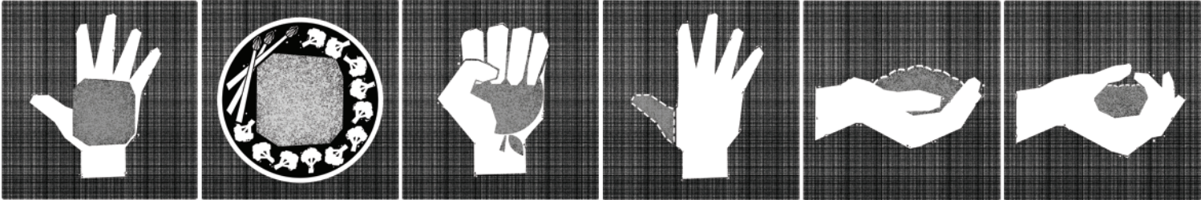
protein
Meal Planning
Making healthy meals easy
Vegetables
Fruit
FAts
Notes:
Now that you know everything that’s NOT permitted with Whole30, we can take a look at what IS compliant. The best way to learn what to eat is with the Whole30 meal plan template that shows recommended portion sizes for the each food group.
(click) For a closer look at this page, use the plate icon to link to the “making healthy meals easy” document.
(click) With all the other major food groups eliminated, you are left with protein, vegetables, fruit, and certain fats.

Slide 12
protein
Meal Planning
Making healthy meals easy
Vegetables
Fruit
FAts
1-2 palm-sized portions
eggs
ground beef
steak
ground chicken
chicken breast/thigh
chicken sausage
whole chicken
ground turkey
whole turkey
turkey breast
salmon
whitefish
shrimp
scallops
seafood
ground pork
pork chops
pork sausage
some bacon
deli meat
Notes:
First, start with your protein. You’ll want 1 or 2 palm-sized portions.
(click) You’ll definitely have to get creative if you’re vegan or vegetarian, but here’s a list of some of the protein options you can eat during Whole30. Always be sure to check the ingredients label though because some meats might be cured in sugar. Bacon and deli meats are especially tricky to find without sugar in them.

Slide 13

protein
Meal Planning
Fresh Produce on a budget
Making healthy meals easy
Vegetables
Fruit
FAts
1-2 palm-sized portions
Fill the rest of the plate
artichoke
arugula
asparagus (C)
beets
bell peppers (D)
bok choy
broccoli
broccolini
brussel sprouts
cabbage
carrots
cauliflower
celery (D)
cherry tomatoes (D)
collard greens (D)
cucumber (D)
eggplant (C)
endive
fennel (anise)
garlic
green beans
jalapeno
hot peppers (D)
kale (D)
leeks
lettuce
mushrooms (C)
okra
onion (C)
parsnips
potatoes
pumpkin
radish
rutabaga
rhubarb
romaine
shallots
snow peas
sugar snap peas
squash (D)
spinach (D)
sprouts
sweet potato (C)
yams
swiss chard
tomato
turnip
zucchini
Notes:
Next, fill the rest of your plate with vegetables for every meal during Whole30.
(click) Here are some examples, but this list is not all-inclusive. There are many other vegetables that you can eat for Whole30.
Notice the D and C in parenthesis after some of these?
(click) The Whole30 website provides a document called “fresh produce on a budget,” that lists the best seasons for buying fruits and vegetables, along with whether or not you should buy organic. The C means clean so you don’t have to buy organic if you’re on a budget. The D stands for dirty, meaning you should try to buy this item organic as often as you can. To view this document, click the apple icon at the top of the slide.

Slide 14
protein
Meal Planning
Fresh Produce on a budget
Making healthy meals easy
Vegetables
Fruit
FAts
1-2 palm-sized portions
Fill the rest of the plate
1 serving occasionally
apples (D)
apricots
bananas
blackberries
blueberries
cherries
dates
figs
grapefruit (C)
grapes (D)
jicama
kiwi (C)
lemons
limes
mango (C)
melon
nectarines (D)
oranges
papaya (C)
peaches (D)
pears
pineapple (C)
plantains
plums
pomegranate
raspberries
strawberries (D)
tangerines
watermelon
Dried fruits
Notes:
Next on the list is fruit, but you shouldn’t be having one of these with every meal. The rule for fruits since they are high in sugar is to have only one serving occasionally. So maybe have a banana for breakfast today and an apple before dinner.
(click) Here are some examples to get ideas flowing, but again this list is not all-inclusive. Dried fruits are permitted as long as they don’t have sugar added.
Notice again the Ds and Cs in parenthesis to note whether or not you should buy organic, and you can view the full document by clicking on the apple at the top.

Slide 15
protein
Meal Planning
Fresh Produce on a budget
Making healthy meals easy
Vegetables
Fruit
FAts
1-2 palm-sized portions
Fill the rest of the plate
1 serving occasionally
Oils & Butters
Coconut & Olives
Nuts & Seeds
1-2 thumb-sized portions
1-2 heaping handfuls
Up to 1 closed handful
coconut oil
extra-virgin olive oil
avocado oil
sesame oil
coconut oil
palm oil
animal fats
ghee
clarified butter
almond butter
coconut butter
sunflower seed butter
coconut flakes
coconut milk
black olives
green olives
almonds
brazil nuts
cashews
hazelnuts
macadamia nuts
pecans
pistachio
flax seeds
pine nuts
pumpkin seeds
sesame seeds
sunflower seeds
walnuts
Notes:
Finally, we have fats, which is split into 3 groups. First is oils and butters. This is your olive oils, ghee, almond butter, avocado oil, etc. Only have 1-2 thumb-sized portions of these kinds of fats with each meal.
(click) Next is coconuts and olives. You’ll only want to have 1-2 open handfuls of these with each meal if this is the fat option you choose.
(click) Last is nuts and seeds. If this is the fat option you’re choosing for your meal, you should aim to have up to 1 closed handful.
Remember, these types of fats are healthy and necessary for a well-balanced diet. So be sure to include an appropriate amount for each meal.

Slide 16

Conclusion
30 days of elimination
  Program rules
  Check the ingredients label!
  Compliant meal planning
10-30 days of reintroduction
Shopping list
Going out to eat during Whole30
Whole30 recipes
Community support
Much more!
Visit the website!
https://whole30.com/
Notes:
Now that you know what you can and can’t eat, you’re ready to start Whole30!
As you near the end of your 30 days, you can come back to learn about the reintroduction phase of the diet. This part is just as important as those first 30 days, so don’t skip it! Remember, you want to learn what each food group does to your body as an individual, and the only way to find out is to reintroduce them one at a time.
The Whole30 website has TONS of useful materials, even more PDFs to download than I mentioned. As you work through the elimination phase, Whole30 has got your back, and can help you with things like shopping lists, going out to eat, recipes, community support, and more.

Slide 17
References and Resources
https://whole30.com/
Shutterstock
https://purepng.com/photo/25338/clipart-pancake
https://www.xtend-life.com/blogs/supplement-ingredients/carrageenan
https://www.amazon.com/Spice-Supreme-Monosodium-Glutamate-Plastic/dp/B076PMPTQG
https://my.clevelandclinic.org/health/articles/11323-sulfite-sensitivity#:~:text=Sulfites%20are%20chemicals%20used%20as,as%20a%20variety%20of%20medications

Slide 18
descriptions
purpose
Audience
The purpose of this presentation is to inform viewers of the program rules of Whole30 and suggest an outline for meal planning. The program rules of this diet are very intense for someone who has never heard of it before, so I wanted to create an informative project that could visually organize them. Once someone sees all of the foods that you can’t eat during Whole30, the next question is always, “So what can I eat then?” My personal experience with this diet provided me an understanding of the kinds of food to go for, and it’s always best understood visually. I wanted to put the meal plan template that Whole30 provides alongside actual examples of foods so the viewer can begin to have an idea of what to expect.
The target audience for this presentation is anyone who has never done Whole30 before and wants to learn more about it. I designed the content in this presentation to cater to someone who might have initial shock once they hear the rules of the program. I know from my own personal experience with Whole30, I originally laughed at the idea and thought it was completely impossible. So, since I didn’t have an actual audience to perform a proper audience analysis, I assumed that many individuals would have a similar mindset to mine. The ideal target audience would be those who are about to begin the diet. Much of this information is exactly what I would tell a friend if they were about to start, based on my past experience with it.
Notes:
Purpose: The purpose of this presentation is to inform viewers of the program rules of Whole30 and suggest an outline for meal planning. The program rules of this diet are very intense for someone who has never heard of it before, so I wanted to create an informative project that could visually organize them. Once someone sees all of the foods that you can’t eat during Whole30, the next question is always, “So what can I eat then?” My personal experience with this diet provided me an understanding of the kinds of food to go for, and it’s always best understood visually. I wanted to put the meal plan template that Whole30 provides alongside actual examples of foods so the viewer can begin to have an idea of what to expect.
Audience: The target audience for this presentation is anyone who has never done Whole30 before and wants to learn more about it. I designed the content in this presentation to cater to someone who might have initial shock once they hear the rules of the program. I know from my own personal experience with Whole30, I originally laughed at the idea and thought it was completely impossible. So, since I didn’t have an actual audience to perform a proper audience analysis, I assumed that many individuals would have a similar mindset to mine. The ideal target audience would be those who are about to begin the diet. Much of this information is exactly what I would tell a friend if they were about to start, based on my past experience with it.

Slide 19
descriptions
How
Where
This presentation would best be presented by a person who can click through the slides with the animations and read the narration from the slide notes. Many of my slides have very few words, so this presentation would not function well as a handout without the slide notes to hear or see.
Since I’m not an educator, I mostly designed this presentation with a target audience of friends in mind, though I did consider a few possibilities for more professional uses. This presentation could be used at group meetings, possibly for those in health-focused groups who are always keen to learn about available diets. This presentation could also possibly benefit students who are studying nutrition or health. The slideshow could be used in college classrooms by a professor or guest speaker.
When
I designed this presentation for use before someone begins the Whole30 diet. Ideally, if a friend told me they were thinking about trying it, I’d show them this slideshow with all of the details so they don’t feel overwhelmed or confused. This presentation could also be used to explain to friends and family what the diet entails while I’m doing it. Since the program is very complex, it’s sometimes easier to visually show someone what the rules are.

Slide 20
Overall design choices
FONT
I chose to use myriad pro as the font family for this presentation because it’s easy to read on the screen, and has several versions to use to separate titles and subtitles from bulleted text. I also think it has a fun but clean personality.
COLOR
The color palette I chose for this presentation began as one of the PowerPoint themes, but I customized the colors to match that of the Whole30 website. They use gray, blue, white, and a little bit of orange, so I wanted to use those in the presentation for consistency when I included the Whole30 logo.
PROGRAM RULES SLIDES
For the program rules slides, I wanted to show an image, a list of foods, a list of ingredients, and an exceptions section. I chose to use rectangular shapes to break up the space on the slide and used different colors to draw the eye to certain parts. I wanted to stay consistent with the slide with the overview of the program rules, so I used the gray-blue outline shape as well. I also didn’t want the learner to feel too overwhelmed by the amount of words on the slides because of the lists, so I chose to use animation to my advantage and delay the entrance of the ingredients list until after the user has had time to look over the first list.
MEAL PLANNING SLIDES
For these slides, I pulled the image of hands from the Whole30 website as the basis of the meal planning template. Then I chose to introduce each food group on its own slide, so the learner can have a chance to see all the potential options for each. I chose to sacrifice the overall balance and negative space composition in order to introduce each food group with a little bit of content at a time. However, the 5th slide in the series that shows all of the food groups with recommended portions is well balanced and functions as a useful infographic, especially since the viewers were already able to focus on each group at a time.

Slide 21
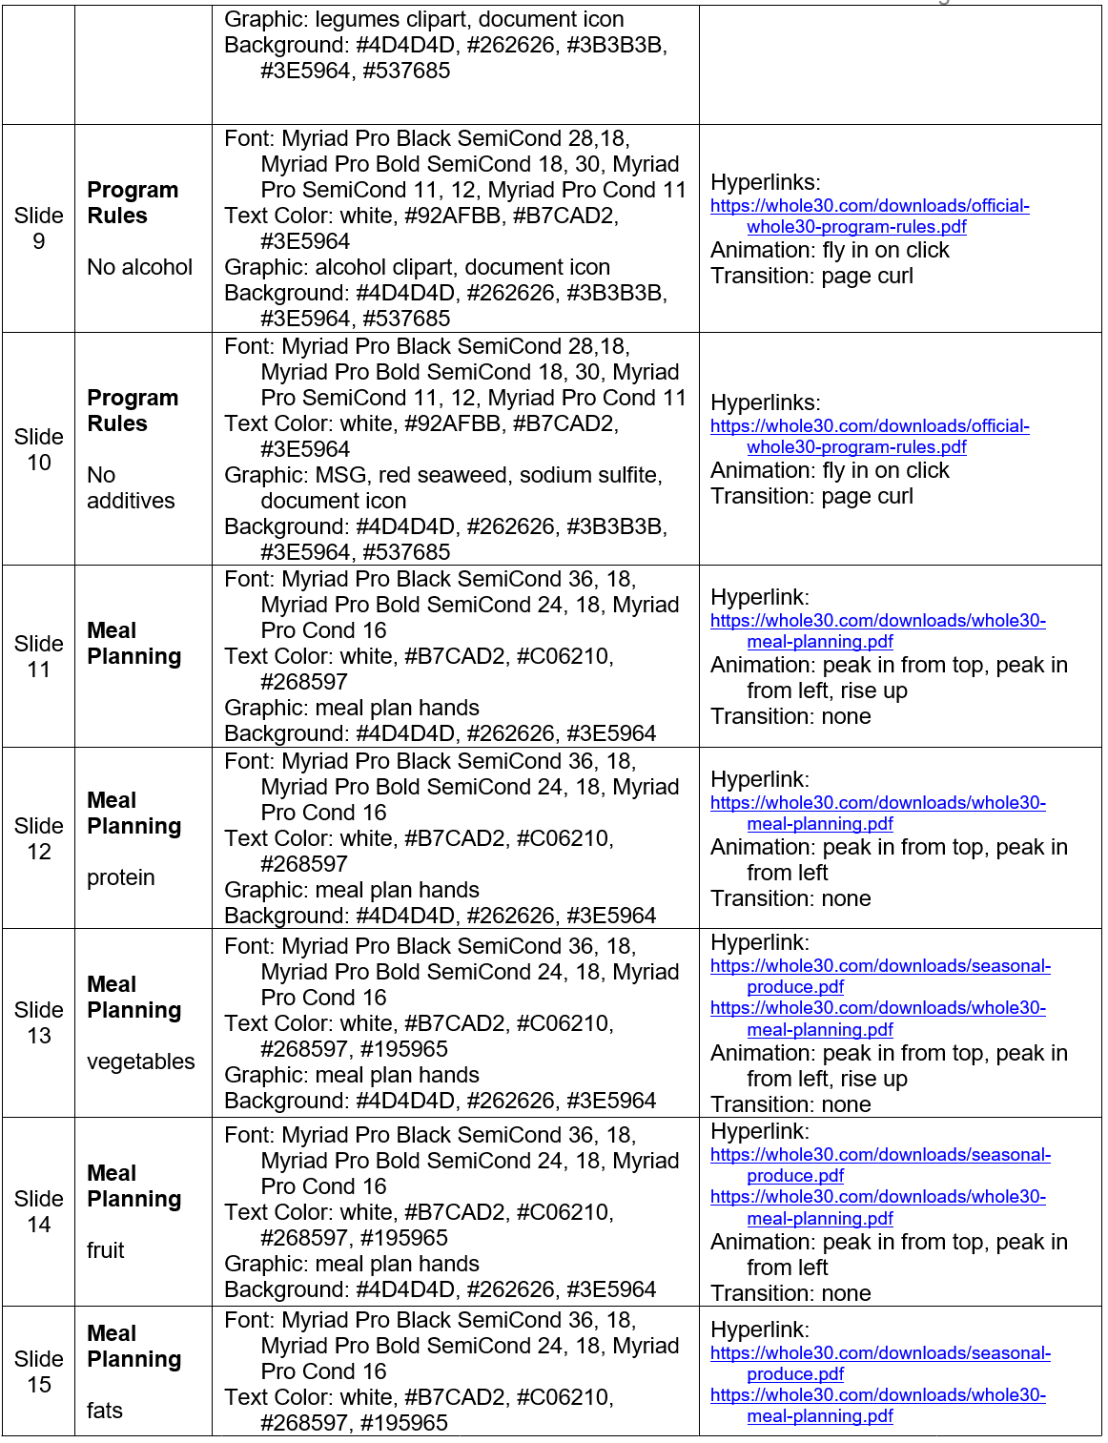
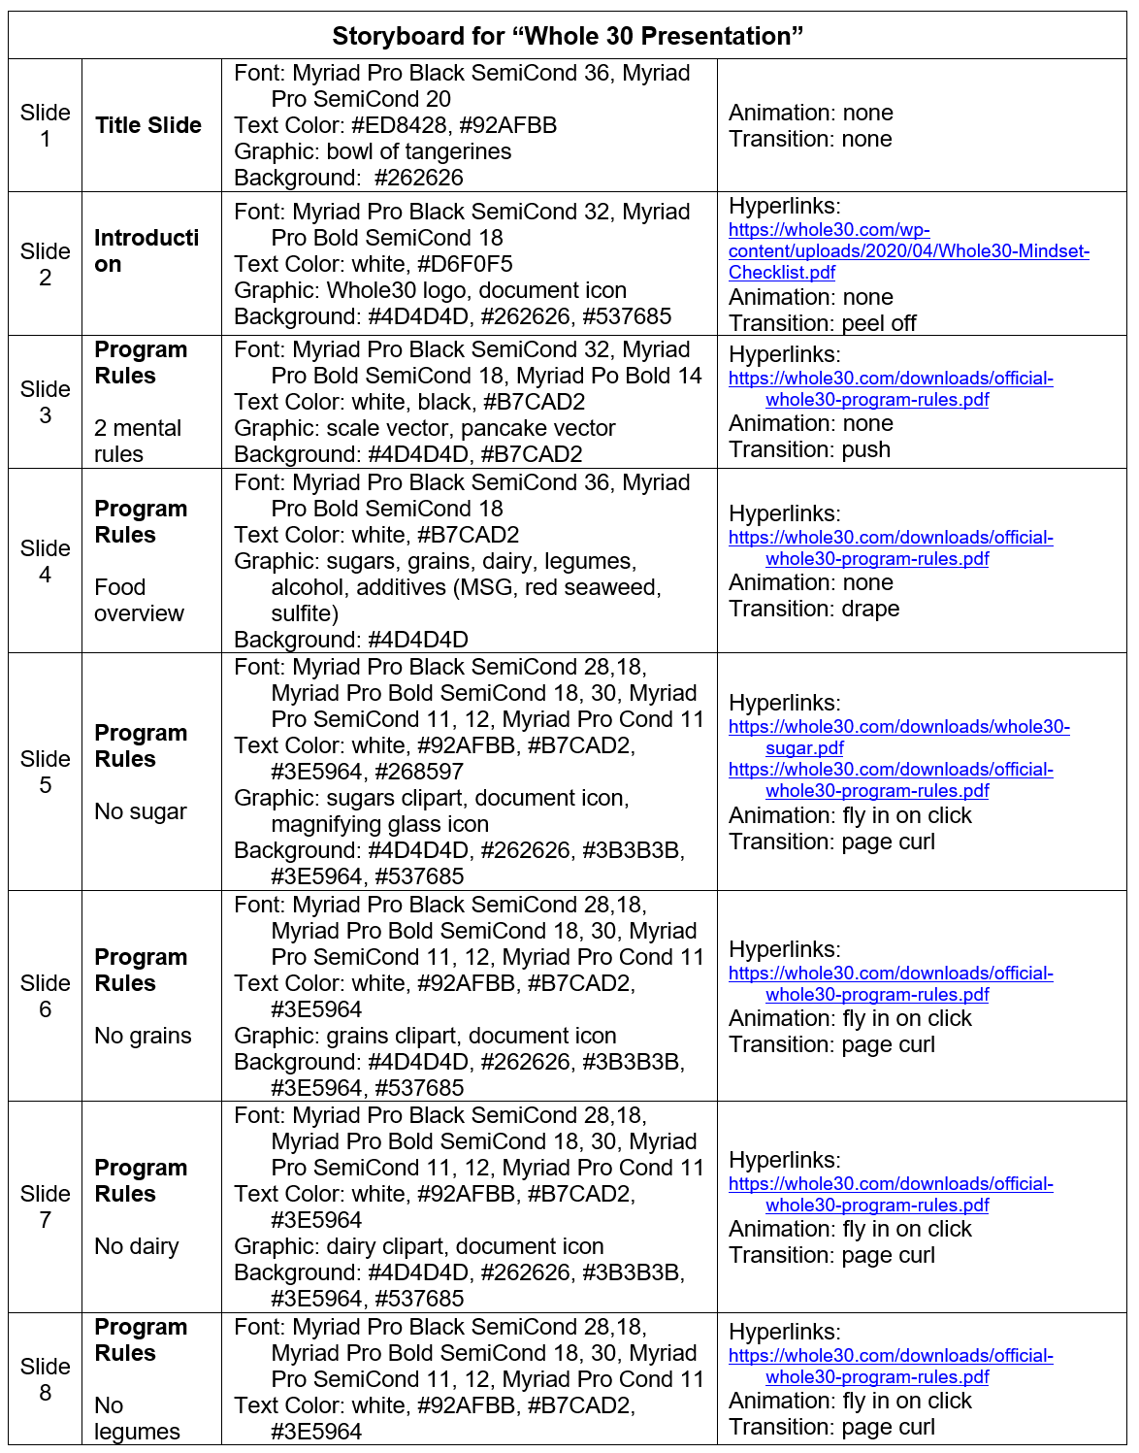
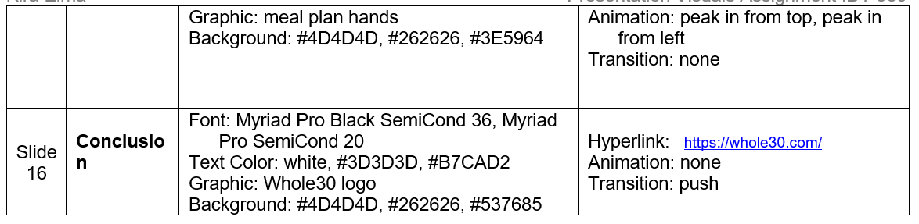
Storyboard

